Slide 1
Erlang and the "100M Problem"
Within the last year, the two dominant US mobile operators have eclipsed 100 million subscribers. Along with this honor comes a host of technology issues ideally suited for Erlang-based solutions.
This talk will explore the perfect storm of opportunity in the mobile industry (and others) including barriers to entry, paths to success, and an extrapolative perspective on where carrier ecosystems are heading. Devoid of Erlang code examples and laden with anecdotes of why the "best" technology doesn't always win.
Talk Objectives:
- Explore the business needs of major corporations facing the "100M Problem", a technology dilemma plaguing those that dared to succeed but not scale.
- Discuss the applicability to Erlang as a core technology to overcoming the problem and laying the foundation for significant ROI.
Target Audience:
- Anyone in the unenviable position of having to sell their Erlang-based technology/solution to someone who doesn't realize they need it.

Slide 2
Erlang and the 100M Problem
A Story about Opportunity
Presented by Roger J Smith, VP – Mobile Solutions, NCS Technologies

Slide 3

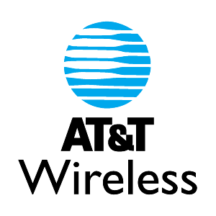
Mobile Data is born (US-version)
$10B
Mobile Multimedia
Services Subsidiary
Notes:
AT&T POCKETNET– THE FIRST MOBILE INTERNET PHONE
By 1997, the Internet was booming. It was also the year that AT&T Wireless unveiled the world’s first mobile Internet phone. Developed by Pacific Communications Sciences Inc., the phone was branded PocketNet, and it looked like a standard mobile phone at the time, but with one major difference – it included a 19.2 Kbps modem running on AT&T’s new Cellular Digital Packet Data (CDPD) network. Two additional phones using the PocketNet service followed: the Mitsubishi Mobile Access (MA120) and the Samsung Duett.
Despite being the first to market with Internet-capable phones, AT&T’s initial phones were not a tremendous success. (Reports suggest that slightly more than 20,000 analog PocketNet phones were sold.) There were many factors that contributed to the relatively slow adoption of the first Internet phone. The PocketNet phone had a three-line, 60-character LCD screen that limited readable text without significant scrolling. This limited its use and appeal, as it was not compatible with most Web sites that were being developed in 1997.
But more importantly, the first PocketNet phone used the analog AMPS network for voice calling at a time when users were demanding digital voice features. The phone had made an interesting leap in technology to support a data connection, but it missed the popular transition at the time to move to the digital voice network (AT&T’s digital TDMA network). Moreover, users selected a channel and network, which meant that a voice call could not be received while a user was in data mode.
Nevertheless, even if it was not a success, it was a start. And the introduction of the first Mobile Internet phone meant that AT&T had formed the teams necessary to operate and market data services. This was an important turning point for a wireless carrier that built its operations around selling voice communication through airwaves. The mobile Internet forced a new way of thinking – AT&T needed to build teams to work with the development and content community that would provide the services behind the PocketNet device.
In 1999, AT&T attempted a second launch of the PocketNet service. Learning from its mistakes with the initial analog version of PocketNet, it rolled out two digital devices: the Ericsson R280LX and the Mitsubishi T250. While the Ericsson phone had the same three-line screen limitation as the initial analog PocketNet device, the Mitsubishi phone had an eight-line screen that made surfing the Web on a mobile device more manageable. Adoption of the digital version of PocketNet was much better than its analog counterpart two years prior (it reached 100,000 subscribers by July 2000).
But it had its own issues. By 2000, AT&T was secretly developing plans to abandon its digital TDMA network (and its accompanying CDPD data network) for the global standard at the time – GSM. GSM would have its equivalent data network, GPRS, so any future investment in the CDPD data network at that time would have been short-lived. Thus, PocketNet came to an end and the Mitsubishi and Ericsson phones became the only digital PocketNet phones to hit the market.
The first PocketNet phones, both analog and digital versions, were powered by technology from Unwired Planet, which later became Phone.com, and then later became Openwave. The technology used a protocol known as Handheld Device Transport Protocol (HDTP), and a markup language known as Handheld Device Markup Language (HDML).
This point is critical as the protocol and markup language differ from the standards developed for the PC Internet. Unwired Planet justified that limitations in the device and network required different technologies for wireless, but as the world soon learned in Japan, that was not necessarily the case. Unfortunately for AT&T, the lesson would not be learned for a few years. Although HDTP/HDML was abandoned when AT&T switched to a GSM network and adopted GPRS capable phones, it also inherited a growing mobile Internet standard in Europe at the time: Wireless Application Protocol (WAP) and Wireless Markup Language (WML).
The protocols and languages again differed from the standard being developed for the PC Internet, causing differentiation between PC and mobile. This differentiation caused issues with sourcing content – as developers building popular PC Web sites had to code to different specifications and use different tools for development and testing. Meanwhile, NTT DoCoMo was taking a different path and its explosive growth, admired by the rest of the world, was attributed to some degree by the technology choice that it made.
After the launch of AT&T’s initial PocketNet service, NTT DOCOMO sent a team to the United States to learn more about the offering as it attempted to build its own data phone. NTT DOCOMO,the largest wireless carrier in Japan, built a strong relationship with AT&T at that time, and would eventually become an investor in AT&T Wireless with a 16 percent stake in the company.

Slide 4
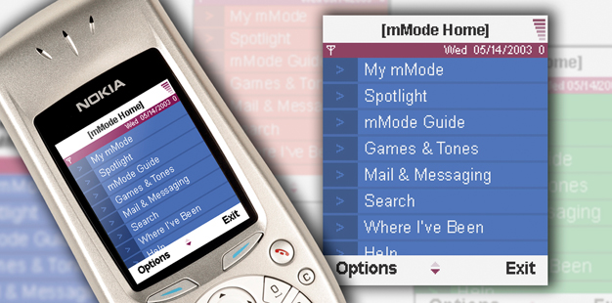

Success demands scale
Almost 8 million
text votes cast in
Season 2.
By Season 8, 178
million text votes
were cast.
One-third of AT&T Wireless GSM subs signed up for
mMode, getting 2MB of data a month for $12.49.

Slide 5
Early Mobile Data Scale Dynamics
mMode – approached 15M users
  Apache Tomcat
  BEA WebLogic
  Oracle RDBMS
  Java, java, java
WAP Gateways – mobile web proxy
SGSN/GGSN - Internet Protocol (IP) enablement of 2G/3G mobile networks
SMSC – “store & forward” for SMS messaging
Notes:
A GSN is a network node which supports the use of GPRS in the GSM core network. All GSNs should have a Gn interface and support the GPRS tunneling protocol. There are two key variants of the GSN, namely Gateway and Serving GPRS Support Node.
[edit] Gateway GPRS Support Node (GGSN)
The Gateway GPRS Support Node (GGSN) is a main component of the GPRS network. The GGSN is responsible for the interworking between the GPRS network and external packet switched networks, like the Internet and X.25 networks.
From an external network's point of view, the GGSN is a router to a sub-network, because the GGSN ‘hides’ the GPRS infrastructure from the external network. When the GGSN receives data addressed to a specific user, it checks if the user is active. If it is, the GGSN forwards the data to the SGSN serving the mobile user, but if the mobile user is inactive, the data is discarded. On the other hand, mobile-originated packets are routed to the right network by the GGSN.
The GGSN is the anchor point that enables the mobility of the user terminal in the GPRS/UMTS networks. In essence, it carries out the role in GPRS equivalent to the Home Agent in Mobile IP. It maintains routing necessary to tunnel the Protocol Data Units (PDUs) to the SGSN that services a particular MS (Mobile Station).
The GGSN converts the GPRS packets coming from the SGSN into the appropriate packet data protocol (PDP) format (e.g., IP or X.25) and sends them out on the corresponding packet data network. In the other direction, PDP addresses of incoming data packets are converted to the GSM address of the destination user. The readdressed packets are sent to the responsible SGSN. For this purpose, the GGSN stores the current SGSN address of the user and his or her profile in its location register. The GGSN is responsible for IP address assignment and is the default router for the connected user equipment (UE). The GGSN also performs authentication and charging functions.
Other functions include subscriber screening, IP Pool management and address mapping, QoS and PDP context enforcement.
With LTE scenario the GGSN functionality moves to SAE gateway (with SGSN functionality working in MME).
[edit] Serving GPRS Support Node (SGSN)
A Serving GPRS Support Node (SGSN) is responsible for the delivery of data packets from and to the mobile stations within its geographical service area. Its tasks include packet routing and transfer, mobility management (attach/detach and location management), logical link management, and authentication and charging functions. The location register of the SGSN stores location information (e.g., current cell, current VLR) and user profiles (e.g., IMSI, address(es) used in the packet data network) of all GPRS users registered with this SGSN....
[edit] Common SGSN Functions
Detunnel GTP packets from the GGSN (downlink)
Tunnel IP packets toward the GGSN (uplink)
Carry out mobility management as Standby mode mobile moves from one Routing Area to another Routing Area
Billing user data
[edit] GSM/EDGE specific SGSN functions
Enhanced Data Rates for GSM Evolution (EDGE) specific SGSN functions and characteristics are:
Maximum data rate of approx. 60 kbit/s (150 kbit/s for EDGE) per subscriber
Connect via frame relay or IP to the Packet Control Unit using the Gb protocol stack
Accept uplink data to form IP packets
Encrypt down-link data, decrypt up-link data
Carry out mobility management to the level of a cell for connected mode mobiles
[edit] WCDMA specific SGSN functions
Carry up to about 42 Mbit/s traffic downlink and 5.8 Mbit/s traffic uplink (HSPA+)
Tunnel/detunnel downlink/uplink packets toward the radio network controller (RNC)
Carry out mobility management to the level of an RNC for connected mode mobiles
These differences in functionality have led some manufacturers to create specialist SGSNs for each of WCDMA and GSM which do not support the other networks, whilst other manufacturers have succeeded in creating both together, but with a performance cost due to the compromises required.

Slide 6

Safeco Field Problem

Slide 7
Apple Effect
Mobile Operator is the pipe. Apple made the pipe “dumb”.
Before the iPhone (2007),…
  Operators were “herding” their subscribers into “walled gardens”
  Standards were optimized for the benefit of the operator rather than the subscriber (or developer)
After the iPhone,…
  Apple shifts focus to the user (customer experience) and developer (rich application SDK and App Store)
  Mobile internet development aligns with “wired” web development
  Operators’ networks get pushed to the max
Notes:
Full fidelity HTML, hi-res pix and video, on EDGE (2.5 G) at launch.

Slide 8
Apple upsets the Operators’ cart
Before the iPhone,…
  Operators managed portals to web content.
  Operators sold wallpapers, ringtones, games, & apps through their own branded storefronts.
  Operators made incremental revenue beyond mobile service.
  Device manufacturers pre-load devices with operators “experience”.
After the iPhone,…
  Users directly surf the web in full fidelity (unproxied).
  Apple sells ringtones, music, games & apps through Apple’s iTunes and App Store.
  Apple makes incremental revenue beyond selling the device.
  Operators are relegated to being the “dumb” pipe.

Slide 9
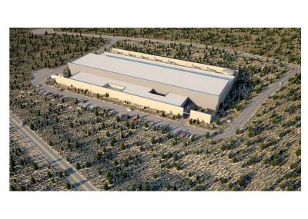

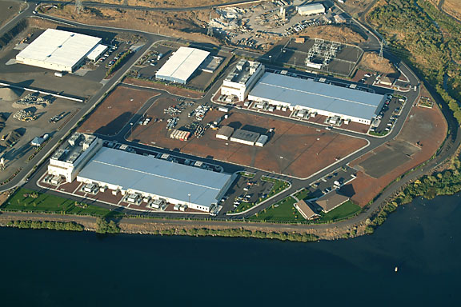
Safeco Field Problem Revisited
Google (OR) – 206,000 sq. ft.
Facebook (OR) – 333,000 sq. ft.
Apple (NC) – 500,000 sq. ft.
Safeco Field – 1,172,172 sq. ft.
(but only 106,000 sq. ft. of turf)

Slide 10
Welcome to the 100 Million Club!
With the help of iOS – and Android:
  The top two US mobile operators have surpassed 100 million subscribers each.
  The US now has more than 100 million smartphone users gobbling up network bandwidth and driving up network utilization.
  Scalability must now be addressed in terms of 100s of millions.

Slide 11
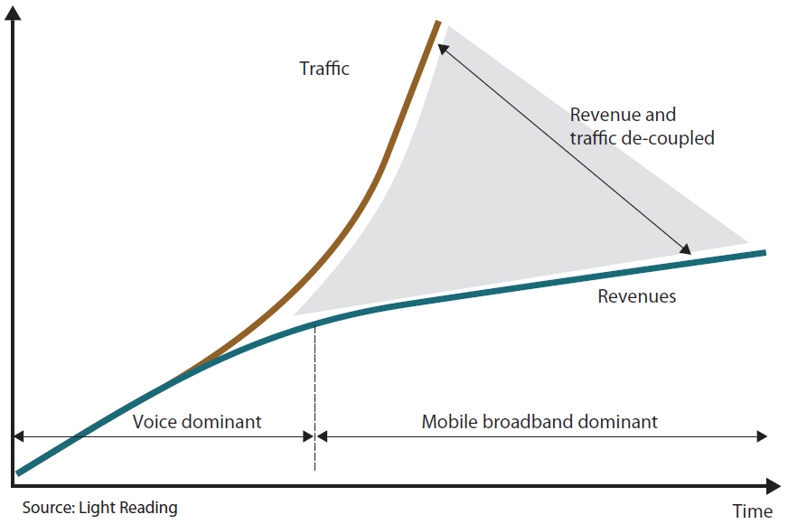
Scissor Effect

Slide 12
What’s an operator to do?
Clearly, operators must prevent a prolonged period where costs exceed revenues.
Margins are under dramatic pressure and they must take actions to address data traffic costs.
Network efficiency will be absolutely key.
In order to manage demand today, operators:
  Cap usage (bye-bye unlimited plans)
  Throttle “undesirable” services (P2P file-sharing)
  Throttle excessive users
In order to meet the ever-increasing demand for more mobile data, operators have the following options:
  Boost network capacity
  Buy additional spectrum
  Increase network intelligence
  Deploy a new network infrastructure
Notes:
Mitigation Strategies
Nevertheless, on the longer term there will be a point that mobile operators’ costs will exceed revenues. Juniper Research forecasts that point will happen within the next four years.³ Currently, mobile operators are already struggling to place themselves favourably in a market that is dominated by handset vendors and operating system providers, but their margins will be under dramatic pressure if they do not take actions to address data traffic costs and if their lack of planning results in inefficient networks with low utilisation rates.
Nevertheless, it is not all doom and gloom as every crisis also offers opportunities. Mobile operators can indeed employ a number of strategies that will mitigate the aforementioned trends.
Firstly, as stated before, network efficiency will be absolutely key as it allows CAPEX to be used most efficiently in order to alleviate OPEX increases related with boosting network capacity, buying additional spectrum, and rolling out new infrastructure to meet the rocketing demand for mobile data. Another supply-side mechanism that can be employed can be consumption caps or deep-packet inspection to throttle certain unwanted services that place a disproportionately large burden on the network such as P2P file-sharing.

Slide 13
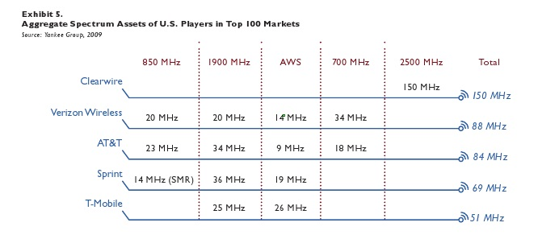
Network Capacity is Challenged
Spectrum – Unlike money, you can’t print more of it.

Slide 14
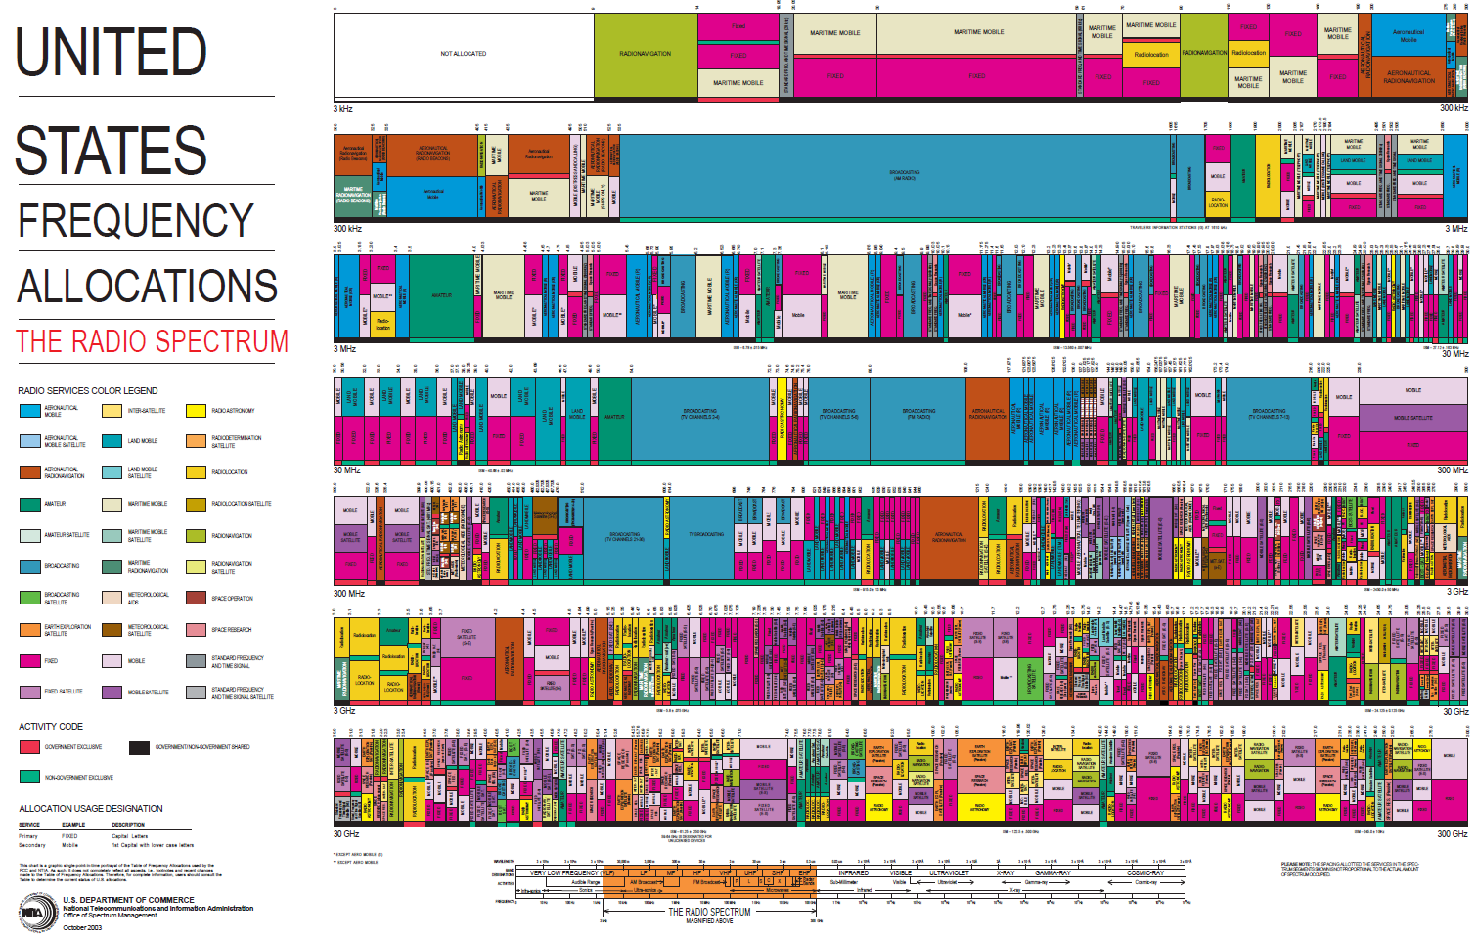
Spectrum is Challenging

Slide 15
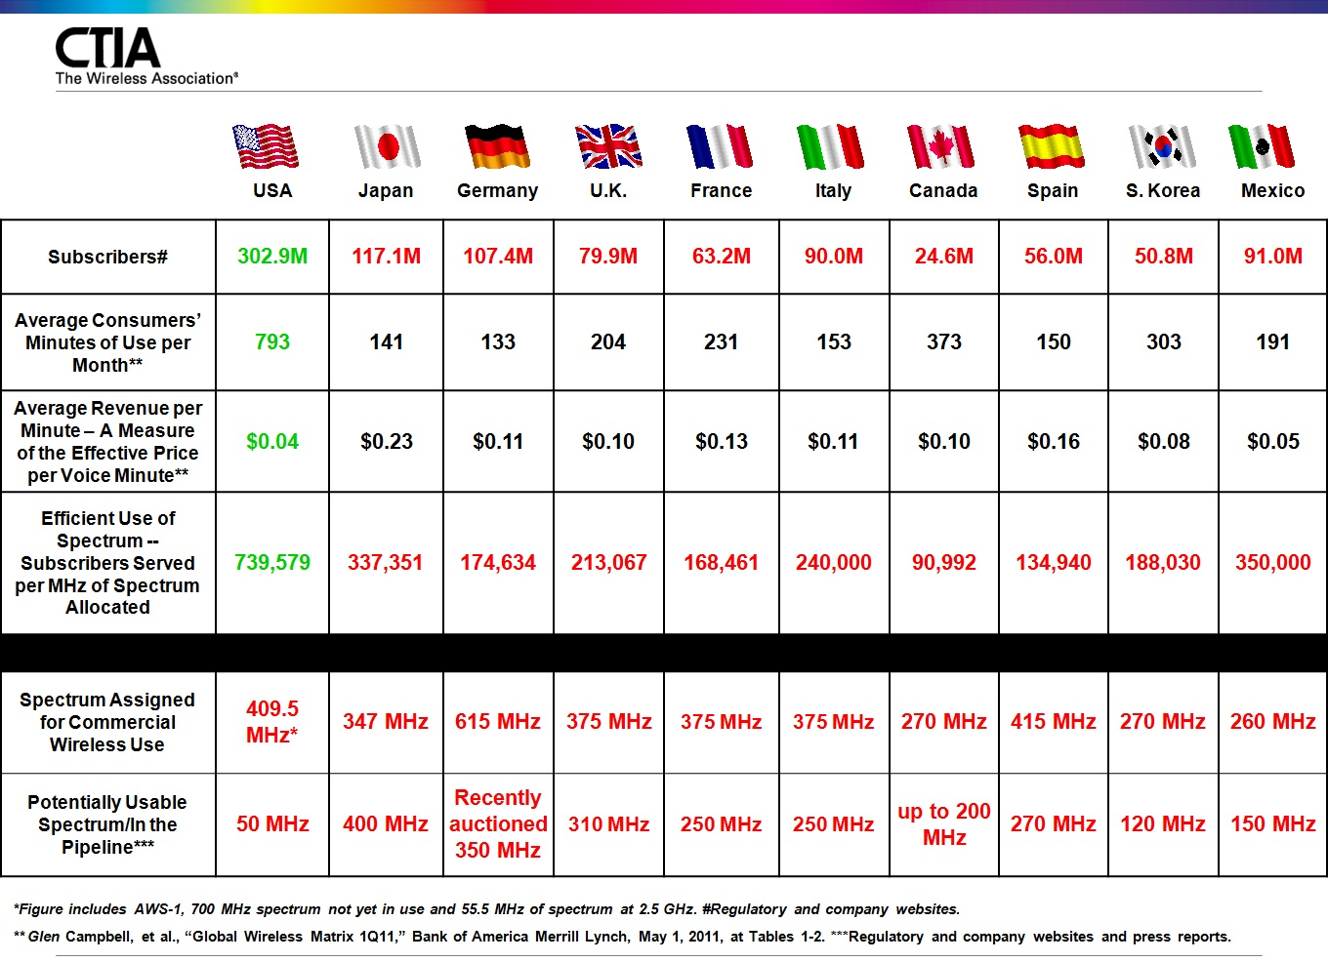
US Spectrum Dilemma

Slide 16
Network Intelligence, theoretically speaking
“Smart” pipe means $ (avoiding the scissor effect).
The key is network intelligence.
Intelligence gathered from the network provides the foundation for building more intelligent services.
SO…operators use things like deep packet inspection to manage traffic.
  Throttle “undesirable” services (P2P file-sharing)
  Throttle excessive users
Will this approach lead to more satisfied customers who are willing to pay more?
Notes:
Avoiding the dreaded scissor effect has become the No.1 priority for mobile carriers.The scissor effect refers to the phenomenon of rising infrastructure costs and flat revenues – an unsustainable situation for any business. The scissor effect already has been witnessed in fixed line networks, and now mobile carriers face the same challenge in relation to mobile data services. Is it possible for mobile carriers to grow revenue per user in line with bandwidth usage?
The key to avoiding the scissor effect is intelligence. You can’t manage what you can’t see, so more intelligence on network and service usage is a fundamental first step. But, intelligence can also be understood as providing smarter services that better meet the needs and expectations of customers and, for which, mobile carriers can earn revenue in line with bandwidth growth. The intelligence gathered from the network lays the foundation for building more intelligent services, which in turn leads to more satisfied customers, who spend more.
Mobile carriers are fully aware of the scissor effect threat and have taken steps to respond with various solutions based on deep packet inspection to manage traffic. This includes services where consumption caps are introduced (i.e. you pay a flat rate up to a certain download limit and higher rates thereafter) and even degradation of performance for undesirable services, such as peer-to-peer downloads.
These approaches are effective, but are they customer-friendly? Will this approach lead to more satisfied customers who are willing to pay more or customers ready to switch providers as soon as the option arises? How easy will it be for a hungry competitor to compete with this model? I think the answers are clear.
An alternative approach is to build a strategy based on understanding and satisfying customer needs and providing services that reflect how they would like to use their mobile data services. The proposition is that by concentrating on providing exactly what customers want, they are less likely to switch provider and are more likely to pay more for the convenience and value their mobile data services provide.
The key to achieving this is intelligence. The first step is gathering intelligence on network and service usage, so we understand how customers are using their mobile data services and that they are receiving the quality of experience they require. With this intelligence, it is possible to tailor services to different types of customer usage scenarios. For example, some customers are more active during the day, others in the evening. Some customers are more active on Facebook, others more interested in news or music downloads.

Slide 17
New Infrastructure: 3GPP Long Term Evolution (LTE)
Is it 4G?
  More like 3.9G but yes
  And so is HSPA+ (apparently)
So it’s faster than 3G?
  Yes, but so is HSPA+
It’s also a simplified, all-IP architecture
  Significant cost efficiencies
  1/3 the cost per MB of existing infrastructure
Is LTE something “you” want or something “they” need?
  Likely both.
Notes:
While most British and European consumers will have to wait until 2014 or 2015 for meaningful LTE offerings, U.S. wireless consumers are being flooded with providers’ competing ads for 4G LTE services that are available today. To be clear: these are not mere commitments or trials, but actual deployments that continue to expand throughout the U.S. These aggressive network buildouts point to why the U.S. is the global leader in mobile broadband. Even though the U.S. comprises less than 5% of the global population and has less than 6% of the world’s mobile wireless subscribers, it boasts about 87% of global LTE subscribers as of 3Q 2011.

Slide 18
Evolved Packet Core (EPC)
Moving to all-IP for mobile.
System Architecture Evolution (SAE) specified for 3GPP LTE includes:
  Evolved UNTS Terrestrial Radio Access Network (E-UTRAN or LTE RAN)
  Evolved Packet Core (EPC)
EPC sits in the middle and makes the entire LTE implementation work.
Brokers interaction with the IMS (IP Multimedia Subsystem) core…including VOIP (VoLTE)!

Slide 19
EPC Scale and the 100M Problem
EPC functions include:
  Policy enforcement
  Packet filtering
  Flow-based charging
  Session management
  DIAMETER routing
These all need to scale to 100M users upon INITIAL implementation
Scalability is absolutely essential as mobile data traffic threatens to swamp mobile networks.
Operators are moving to commodity HW with hopes that:
  The underlying server chipsets continue to increase in performance
  The chipsets’ cores continue to evolve with increasingly higher densities
Notes:
Since multiple systems will need to be deployed at critical locations in the network, it is important to base development on a cost-effective, high-performance, reliable and, most importantly, scalable platform.
Scalability is absolutely essential as mobile data traffic threatens to swamp mobile networks. The advantage of standard servers is that the underlying server chipsets are increasing performance by up to 60 percent each year. What’s more, these chipsets are based on multiple cores with higher densities available on an annual basis. The availability of more and faster processing cores each year provides an opportunity to scale performance as and when new standard servers are available.
Avoiding the scissor effect requires intelligence. To build intelligent services, you need network intelligence based on systems that are built intelligently. Only by re-thinking how services are provided, how networks are built, and how systems are developed can we hope to respond quickly enough to the challenges that will face mobile carriers over the coming years.

Slide 20
How they will try…and fail…to scale.
Implement current technology
Blame the vendors
Throw HW at it
Blame the vendors
Virtualization
Blame the vendors
Now what?

Slide 21
The Opportunity
  Avoiding the scissor effect requires new network infrastructure, functions and services that are more intelligent.
  There is a lack of stable, reliable, scalable solutions available today and the need is growing greater with each day.
  The time is now to re-think how services are provided, how networks are built, and how systems are developed in order to respond quickly enough to the challenges that will face mobile carriers over the coming years.
  So…how do you deliver network-based software services that can scale to meet the needs of 100s of millions of voracious users AND leverage investments in multi-core/multi-proc hardware?
Notes:
Mobile data traffic will reach the following milestones within the next five years.
• Monthly global mobile data traffic will surpass 10 exabytes in 2016.
• Over 100 million smartphone users will belong to the "gigabyte club" (over 1 GB per month) by 2012.
• The number of mobile-connected devices will exceed the world's population in 2012.
• The average mobile connection speed will surpass 1 Mbps in 2014.
• Due to increased usage on smartphones, handsets will exceed 50 percent of mobile data traffic in 2014.
• Monthly global mobile data traffic will surpass 10 exabytes in 2016.
• Monthly mobile tablet traffic will surpass 1 exabyte per month in 2016.
• Tablets will exceed 10 percent of global mobile data traffic in 2016.
• China will exceed 10 percent of global mobile data traffic in 2016.
Global mobile data traffic will increase 18-fold between 2011 and 2016. Mobile data traffic will grow at a compound annual growth rate (CAGR) of 78 percent from 2011 to 2016, reaching 10.8 exabytes per month by 2016.
By the end of 2012, the number of mobile-connected devices will exceed the number of people on earth, and by 2016 there will be 1.4 mobile devices per capita. There will be over 10 billion mobile-connected devices in 2016, including machine-to-machine (M2M) modules-exceeding the world's population at that time (7.3 billion).
Mobile network connection speeds will increase 9-fold by 2016. The average mobile network connection speed (189 kbps in 2011) will exceed 2.9 megabits per second (Mbps) in 2016.
In 2016, 4G will be 6 percent of connections, but 36 percent of total traffic. In 2016, a 4G connection will generate 9 times more traffic on average than a non-4G connection.
By 2016, 39 percent of all global mobile devices could potentially be capable of connecting to an IPv6 mobile network. Over 4 billion devices will be IPv6-capable in 2016.
Two-thirds of the world's mobile data traffic will be video by 2016. Mobile video will increase 25-fold between 2011 and 2016, accounting for over 70 percent of total mobile data traffic by the end of the forecast period.
Mobile-connected tablets will generate almost as much traffic in 2016 as the entire global mobile network in 2012. The amount of mobile data traffic generated by tablets in 2016 (1.1 exabytes per month) will be approximately equal to the total amount of global mobile data traffic in 2012 (1.3 exabytes per month).
The average smartphone will generate 2.6 GB of traffic per month in 2016, a 17-fold increase over the 2011 average of 150 MB per month. Aggregate smartphone traffic in 2016 will be 50 times greater than it is today, with a CAGR of 119 percent.
By 2016, over 3.1 exabytes of mobile data traffic will be offloaded to the fixed network by means of dual-mode devices and femtocells each month. Without dual-mode and femtocell offload of handset and tablet traffic, total mobile data traffic would grow at a CAGR of 84 percent between 2011 and 2016 (21-fold growth), instead of the projected CAGR of 78 percent (18-fold growth).
The Middle East and Africa will have the strongest mobile data traffic growth of any region at 104 percent CAGR. This region will be followed by Asia Pacific at 84 percent and Central and Eastern Europe at 83 percent.
China will account for over 10 percent of global mobile data traffic in 2016, up from less than 5 percent in 2011.

Slide 22

Notes:
The Mobile Network in 2011 and 2012
Global mobile data traffic grew 2.3-fold in 2011, more than doubling for the fourth year in a row. The 2011 mobile data traffic growth rate was higher than anticipated. Last year's forecast projected that the growth rate would be 131 percent. This year's estimate is that global mobile data traffic grew 133 percent in 2011.
Last year's mobile data traffic was eight times the size of the entire global Internet in 2000. Global mobile data traffic in 2011 (597 petabytes per month) was over eight times greater than the total global Internet traffic in 2000 (75 petabytes per month).
Mobile video traffic exceeded 50 percent for the first time in 2011. Mobile video traffic was 52 percent of traffic by the end of 2011.
Mobile network connection speeds grew 66 percent in 2011. Globally, the average mobile network downstream speed in 2011 was 315 kilobits per second (kbps), up from 189 kbps in 2010. The average mobile network connection speed for smartphones in 2011 was 1344 kbps, up from 968 kbps in 2010.
In 2011, a fourth-generation (4G) connection generated 28 times more traffic on average than a non-4G connection. Although 4G connections represent only 0.2 percent of mobile connections today, they already account for 6 percent of mobile data traffic.
The top 1 percent of mobile data subscribers generate 24 percent of mobile data traffic, down from 35 percent 1 year ago. According to a mobile data usage study conducted by Cisco, mobile data traffic has evened out over the last year and now approaches the 1:20 ratio that has been true of fixed networks for several years.
Average smartphone usage nearly tripled in 2011. The average amount of traffic per smartphone in 2011 was 150 MB per month, up from 55 MB per month in 2010.
Smartphones represent only 12 percent of total global handsets in use today, but they represent over 82 percent of total global handset traffic. In 2011, the typical smartphone generated 35 times more mobile data traffic (150 MB per month) than the typical basic-feature cell phone (which generated only 4.3 MB per month of mobile data traffic).
Globally, 33 percent of handset and tablet traffic was offloaded onto the fixed network through dual-mode or femtocell in 2011. In 2011, 72 petabytes of smartphone and tablet traffic were offloaded onto the fixed network each month. Without offload, traffic originating from phones and tablets would have been 217 petabytes per month rather than 147 petabytes per month in 2011.
Android is now higher than iPhone levels of data use. Toward the end of 2011, Android consumption was equal to iPhone consumption, if not higher, in the United States and Western Europe.
In 2011, 10 percent of mobile devices were potentially IPv6-capable. This estimate is based on network connection speed and OS capability.
In 2011, the number of mobile-connected tablets tripled to 34 million, and each tablet generated 3.4 times more traffic than the average smartphone. In 2011, mobile data traffic per tablet was 517 MB per month, compared to 150 MB per month per smartphone.
There were 175 million laptops on the mobile network in 2011, and each laptop generated 22 times more traffic than the average smartphone. Mobile data traffic per laptop was 2.1 GB per month, up 46 percent from 1.5 GB per month in 2010.
Nonsmartphone usage increased 2.3-fold to 4.3 MB per month in 2011, compared to 1.9 MB per month in 2010. Basic handsets still make up the vast majority of devices on the network (88 percent).
The Mobile Network Through 2016

Slide 23
Looking Forward
EPC for all IP (hello wireline!)
Growth beyond subscriber
  Multiple devices per subscriber
  Emerging devices (Telematics, gaming)
  M2M (Smart metering, inventory and fleet management)
The 500M Problem is coming!
Notes:
Cellular communication between objects, machines, or sensors has led to the growth of M2M connections. These connections are in the form of smart metering, business and consumer surveillance, inventory management, fleet management, and healthcare modules, all of which are designed for operational excellence. M2M technologies are being used across a broad spectrum of industries. As real-time information monitoring is helping companies to deploy new video-based security systems and hospitals and helping healthcare professionals to remotely monitor the progress of their patients, bandwidth-intensive M2M connections become more prevalent. Traditional appliances and devices, such as home appliances, vehicles, energy meters, and vending machines-which traditionally have not been connected directly to cellular networks-are now entering the network.
High-bandwidth scenarios for M2M are becoming real in many categories, including the following.
• Business and consumer security and surveillance: Video streams such as commercial security cameras, nannycams, and petcams, accessed through mobile-enabled residential or commercial gateways, fall into this category.
• Health care: In the medical, well-being, and sports and fitness industries, devices and services used by medical personnel are being connected to reduce errors.
• Inventory and fleet management: Wi-Fi is being considered as an adjunct to cellular-based fleet management connectivity, to allow a vehicle to use cellular technology in the field, and support lower-cost, higher-speed Wi-Fi to download and upload data while in fleet headquarters and loading areas.
• Telematics: Trip assistance, navigation, and vehicle management are gaining greater consumer adoption, along with broadband-to-the-car offerings that use a cellular connection to the vehicle and then distribute the connection to notebook PCs and other devices within the vehicle through Wi-Fi.
M2M capabilities similar to mobile devices are migrating from second-generation (2G) to 3G and 4G technologies. Globally, M2M traffic will grow 22-fold from 2011 to 2016, a compound annual growth rate of 86 percent, with M2M traffic reaching 508,022 terabytes per month in 2016. M2M will account for 5 percent of total mobile data traffic in 2016, compared to 4 percent at the end of 2011. The average M2M module will generate 266 megabytes of mobile data traffic per month in 2016, up from 71 megabytes per month in 2011 (Figure 14).

Slide 24
Thanks!

