Slide 1
Devops + Erlang Location Transparency
Michael Bakkemo
Noah Gift
@Loggly

Slide 2
Loggly Stack
EC2
Mongo
Python
Erlang
Java
Solr
Javascript

Slide 3
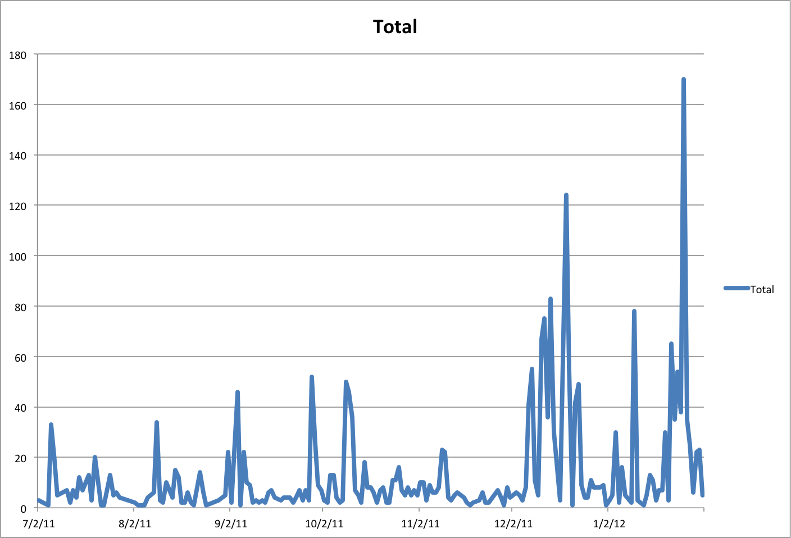
Cloud Pain: Six Months of Alerts

Slide 4
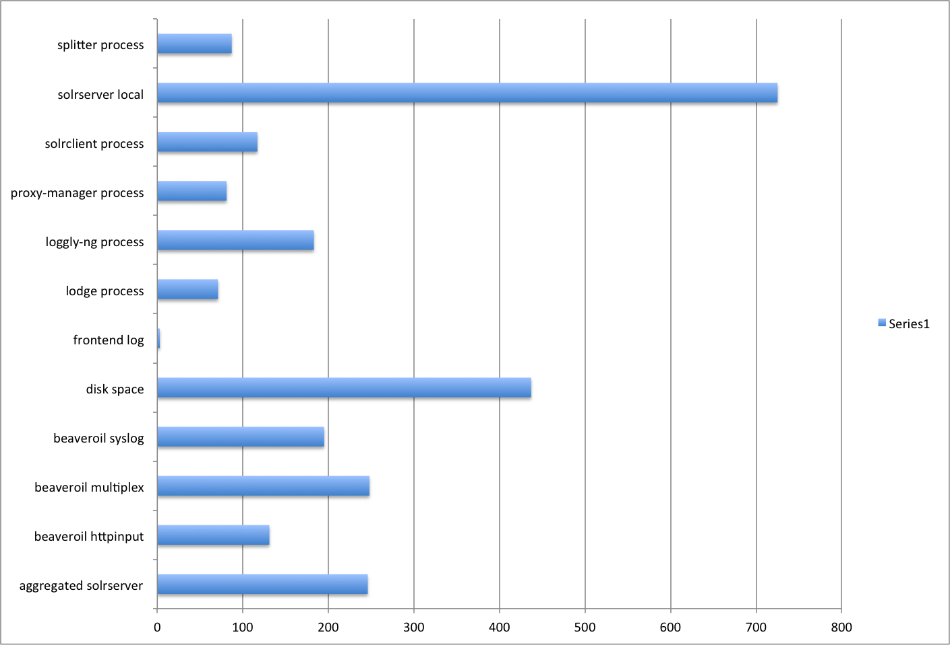
Problem: Process Management In The Cloud

Slide 5

They all Fail
Or rather….

Slide 6

They all Fail
Or rather….

Slide 7
What We Used Before
Supervisord(Python based process management tool)
  We added a new tool that forked off child processes…..
    It blew up
    Didn’t restart things reliably
    Not cluster aware
    Doesn’t have good monitoring or logging integration

Slide 8
Why Not Other Process Management Solutions
Armstrong Corollary on Greenspun's 10th Rule of Programming
We need to heavily customize it
Pick the right tool for the job
A few us knew Erlang….

Slide 9
Armstrong Corollary on Greenspun's 10th Rule of Programming
All sufficiently complicated distributed systems contain ad hoc, informally-specified, bug-ridden, slow implementation of half of Erlang –and if they don't they are probably severely mis-designed.

Slide 10
Doesn’t OTP Do That?

Slide 11
Doesn’t OTP Do That?
YES!

Slide 12
Doesn’t OTP Do That?
YES!
  Kinda, for Erlang processes only

Slide 13

Doesn’t OTP Do That?
YES!
  Kinda, for Erlang processes only

Slide 14

Doesn’t OTP Do That?
YES!
  Kinda, for Erlang processes only
YES!
  Oh, crap…

Slide 15
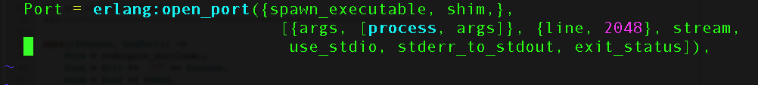
Doesn’t OTP Do That?
YES!
  Kinda, for Erlang processes only
  Ick…

Slide 16
Doesn’t OTP Do That?
YES!
  Kinda, for Erlang processes only
  Ick…
  That shim needs to be smart

Slide 17
Doesn’t OTP Do That?
  Let’s talk about Loom…….

