Slide 1

Using Software Refactoring to Form Parallel Programs: the ParaPhrase Approach
Kevin Hammond, Chris Brown
University of St Andrews, Scotland
http://www.paraphrase-ict.eu
@paraphrase_fp7

Slide 2
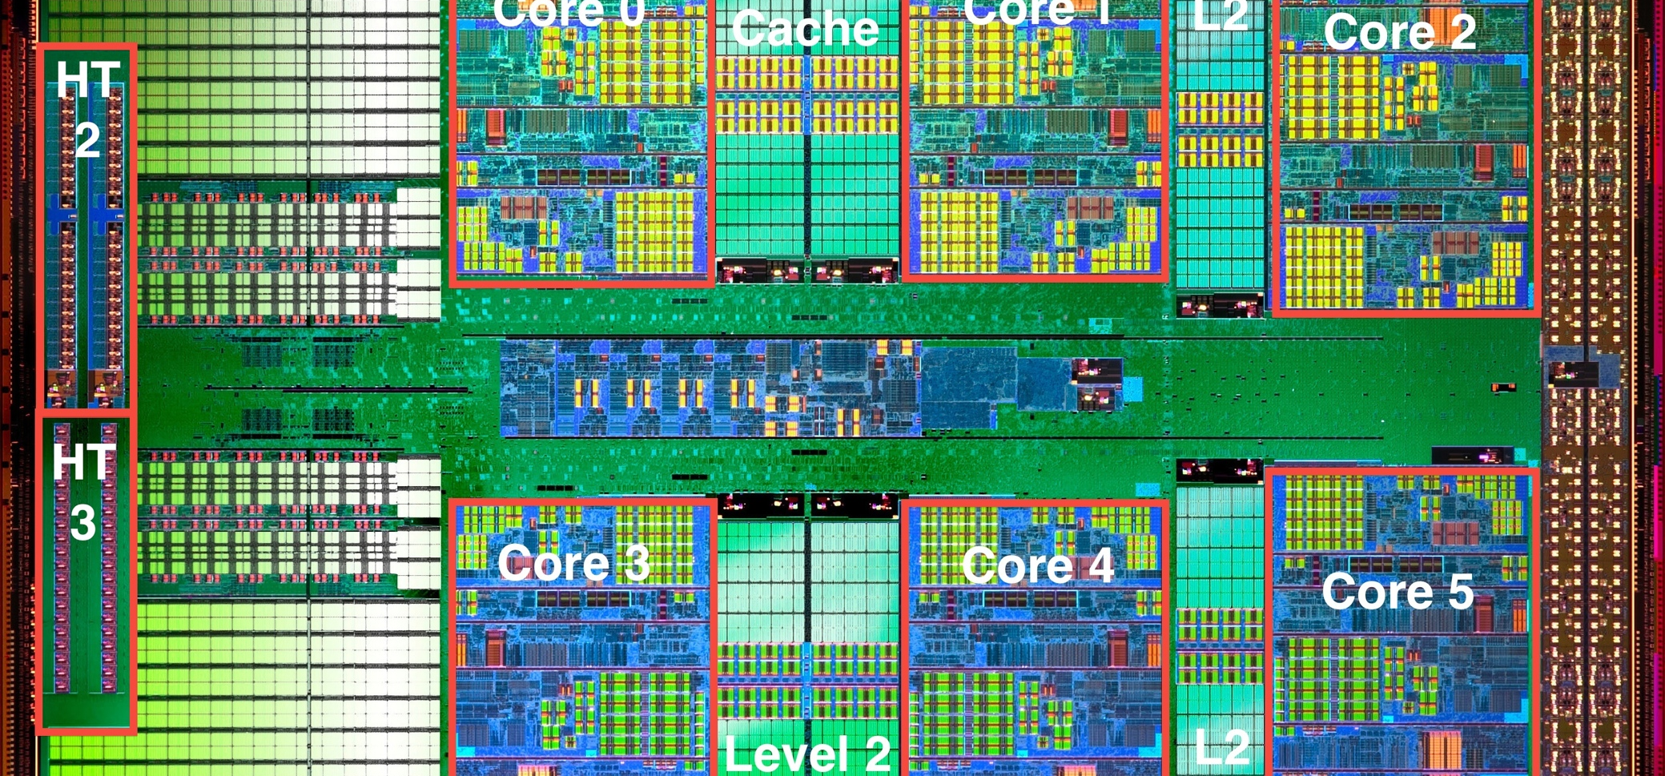
The Dawn of a New Multicore Age
AMD Opteron Magny-Cours , 6-Core (source: wikipedia)

Slide 3
The Near Future: Scaling toward Manycore

Slide 4
The Future: “megacore” computers?
Hundreds of thousands, or millions, of cores
Core
Core
Core
Core
Core
Core
Core
Core
Core
Core
Core
Core
Core
Core
Core
Core
Core
Core
Core
Core
Core
Core
Core
Core
Core
Core
Core
Core
Core
Core
Core
Core
Core
Core
Core
Core
Core
Core
Core
Core
Core
Core
Core
Core
Core
Core
Core
Core
Core
Core
Core
Core
Core
Core
Core
Core
Core
Core
Core
Core
Core
Core
Core
Core
Core
Core
Core
Core
Core
Core
Core
Core
Core
Core
Core
Core
Core
Core
Core
Core

Slide 5
What will “megacore” computers look like?
Probably not just scaled versions of today’s multicore
  Perhaps hundreds of dedicated lightweight integer units
  Hundreds of floating point units (enhanced GPU designs)
  A few heavyweight general-purpose cores
  Some specialised units for graphics, authentication, network etc
  possibly soft cores (FPGAs etc)
  Highly heterogeneous
Probably not uniform shared memory
  NUMA is likely, even hardware distributed shared memory
  or even message-passing systems on a chip
  shared-memory will not be a good abstraction

Slide 6
The Implications for Programming
We must program heterogeneous systems in an integrated way
it will be impossible to program each kind of core differently
it will be impossible to take static decisions about placement etc
it will be impossible to know what each thread does

Slide 7
The Challenge
“Ultimately, developers should start thinking about tens, hundreds, and thousands of cores now in their algorithmic development and deployment pipeline.”
Anwar Ghuloum, Principal Engineer, Intel Microprocessor Technology Lab
“The dilemma is that a large percentage of mission-critical enterprise applications will not ``automagically'' run faster on multi-core servers. In fact, many will actually run slower. We must make it as easy as possible for applications programmers to exploit the latest developments in multi-core/many-core architectures, while still making it easy to target future (and perhaps unanticipated) hardware developments.”
Patrick Leonard, Vice President for Product Development
Rogue Wave Software

Slide 8
Programming Issues
We can muddle through on 2-8 cores
  maybe even 16 or so
  modified sequential code may work
  we may be able to use multiple programs to soak up cores
  BUT larger systems are much more challenging
    typical concurrency techniques will not scale

Slide 9

How to build a wall
(with apologies to Ian Watson, Univ. Manchester)

Slide 10
How to build a wall faster

Slide 11
How NOT to build a wall
Task identification is not the only problem…
Must also consider Coordination, communication, placement,
scheduling, …

Slide 12
We need structure
We need abstraction
We don’t need another brick in the wall

Slide 13
Parallelism in the Mainstream
Mostly procedural
  do this, do that
Parallelism is a “bolt-on” afterthought:
  Threads
  Message passing
  Mutexes
  Shared Memory
Results in lots of pain
  Deadlocks
  race conditions
  synchronization
  non-determinism
  etc. etc.

Slide 14
A critique of typical current approaches
Applications programmers must be systems programmers
  insufficient assistance with abstraction
  too much complexity to manage
Difficult/impossible to scale, unless the problem is simple
Difficult/impossible to change fundamentals
  scheduling
  task structure
  migration
Many approaches provide libraries
  they need to provide abstractions

Slide 15
Thinking in Parallel
Fundamentally, programmers must learn to “think parallel”
  this requires new high-level programming constructs
  you cannot program effectively while worrying about deadlocks etc
    they must be eliminated from the design!
  you cannot program effectively while fiddling with communication etc
    this needs to be packaged/abstracted!

Slide 16
A Solution?
“The only thing that works for parallelism is functional programming”
Bob Harper, Carnegie Mellon

Slide 17
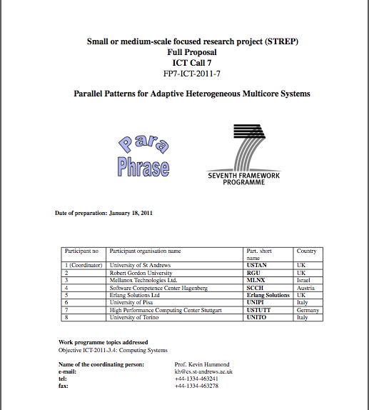
  The ParaPhrase Project (ICT-2011-288570)
€3.5M FP7 STReP Project
9 partners in 5 countries
3 years
Starts 1/10/11
Coordinated from St Andrews

Slide 18
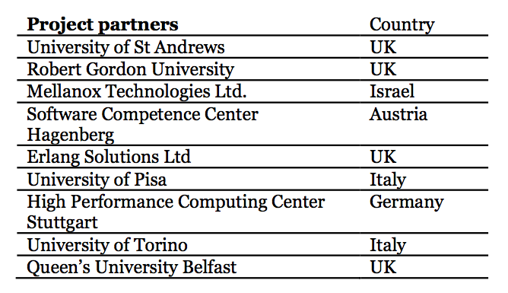
Project Consortium

Slide 19
ParaPhrase Aims
Our overall aim is to produce a new pattern-based approach to programming parallel systems.

Slide 20
ParaPhrase Aims (2)
Specifically,
develop high-level design and implementation patterns
develop new dynamic mechanisms to support adaptivity for heterogeneous multicore/manycore systems

Slide 21
ParaPhrase Aims (2)
verify that these patterns and adaptivity mechanisms can be used easily and effectively.
ensure that there is scope for widespread takeup
We are applying our work in two main language settings
Erlang Commercial Functional
C/C++ Imperative

Slide 22
Thinking in Parallel, Revisited
Direct programming using e.g. spawn
Parallel stream-based approaches
Coordination approaches
Pattern-based approaches
Avoid issues such as deadlock etc…
Parallelism by Construction!

Slide 23

Patterns…
Patterns
    Abstract generalised expressions of common algorithms
      Map, Fold, Function Composition, Divide and Conquer, etc.
  map(F, XS) -> [ F(X) || X <- XS].

Slide 24
The ParaPhrase Model
Erlang
C/C++
Haskell
Costing/profiling
Refactorer
Patterns
Erlang
C/C++
Haskell

Slide 25
Refactoring
Refactoring is about changing the structure of a program’s source code
  … while preserving the semantics
Review
Refactor
Refactoring = Condition + Transformation

Slide 26
ParaPhrase Approach
Start bottom-up
  identify (strongly hygienic) components
  using refactoring
Think about the PATTERN of parallelism
Structure the components into a parallel program
  using refactoring
Restructure if necessary!
  using refactoring

Slide 27
Refactoring from Patterns

Slide 28
Static Mapping

Slide 29
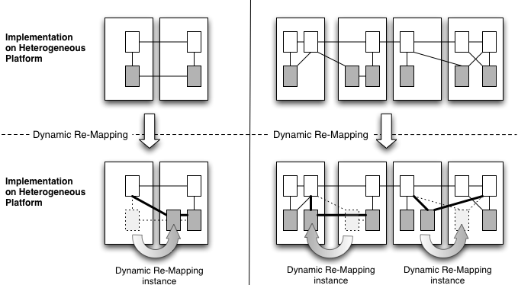
Dynamic Re-Mapping

Slide 30
But will this scale??

Slide 33
Generating Parallel Erlang Programs from High-Level Patterns using Refactoring
Chris Brown, Kevin Hammond
University of St Andrews
May 2012

Slide 34

Wrangler: the Erlang Refactorer
Developed at the University of Kent
  Simon Thompson and Huiqing Li
Embedded in common IDEs: (X)Emacs, Eclipse.
Handles full Erlang language
Faithful to layout and comments
Undo
Built in Erlang, and applies to the tool itself

Slide 35
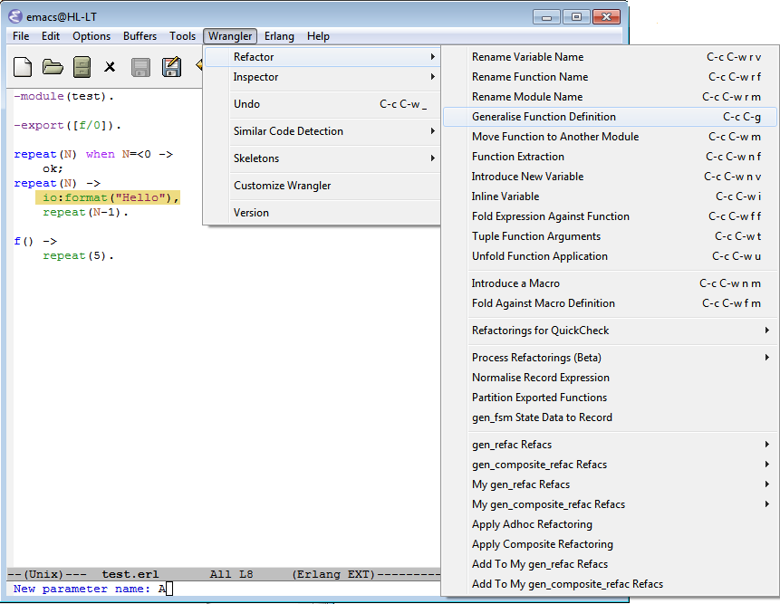

Slide 36

Sequential Refactoring
Renaming
Inlining
Changing scope
Adding arguments
Generalising Definitions
Type Changes

Slide 37
Parallel Refactoring!
New approach to parallel programming
Tool support allows programmers to think in parallel
  Guides the programmer step by step
  Database of transformations
  Warning messages
  Costing/profiling to give parallel guidance
More structured than using e.g. spawn directly
  Helps us get it “Just Right”

Slide 38
Patterns…
Patterns
    Abstract generalised expressions of common algorithms
      Map, Fold, Function Composition, Divide and Conquer, etc.
  map(F, XS) -> [ F(X) || X <- XS].

Slide 39

…and Skeletons
Skeletons
  Implementations of patterns
    Parallel Map, Farm, Workpool, etc.

Slide 40
Example Pattern: parallel Map
map(F, List) -> [ F(X) || (X) <- List ]
map(fun(X) -> X + 1 end, [ 1..10 ]) ->
[ 1 + 1, 2 + 1, ... 10 + 1 ]
map (Complexfun, Largelist) -> [ Complexfun(X1), ...
Can be executed in parallel provided the results are independent

Slide 41
Example Implementation: Data Parallel

Slide 42
Implementation: Task Farm
[t1, …, tn]
[t1, t5, t9, …]
[t2, t6, t10, …]
[t3, t7, t11, …]
[t4, t8, t12, …]
w
w
w
w
[r1, r5, r9, …]
[r2, r6, r10, …]
[r3, r7, r11, …]
[r4, r8, r12, …]
[r1, …, rn]

Slide 43
Implementation: Workpool

Slide 44
Implementation: mapReduce
partitioned
input data
intermediate data sets
partially-reduced
results
input data
mapF
reduceF
results
…
…
…
…
…
reduceF
overall
reduce function
mapF
reduceF
mapping
function
local
reduce function

Slide 45
Map Skeleton
worker(Pid, F, [X]) -> Pid ! F(X).
accumulate(0, Result) -> Result;
accumulate(N, Result) ->
receive
Element ->
accumulate(N-1, [Element|Result])
end.
parallel_map(F, List) ->
lists:foreach(
fun (Task) ->
spawn(skeletons2, worker, [self(), F, [Task]])
end, List
),
lists:reverse(accumulate(length(List), [])).

Slide 46
Fibonacci
fib(0) -> 0;
fib(1) -> 1;
fib(N) ->
fib(N - 1) + fib(N - 2).

Slide 47
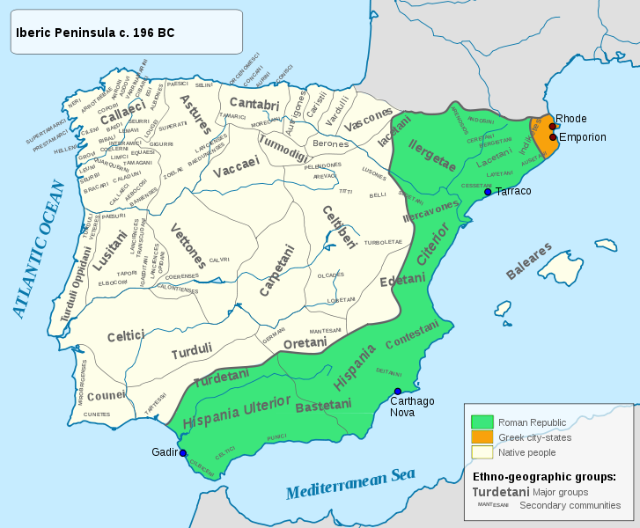
Divide-and-Conquer (wikipedia)

Slide 48
Classical Divide and Conquer
Split the input into N tasks
Compute over the N tasks
Combine the results

Slide 49
Fibonacci
fib(0) -> 0;
fib(1) -> 1;
fib(N) ->
fib(N - 1) + fib(N - 2).
Introduce N-1 as a local definition

Slide 50
Fibonacci
fib(0) -> 0;
fib(1) -> 1;
fib(N) ->
L = N-1,
fib(L) + fib(N - 2).

Slide 51
Fibonacci
fib(0) -> 0;
fib(1) -> 1;
fib(N) ->
L = N-1,
fib(L) + fib(N - 2).
Introduce N-2 as a local definition

Slide 52
Fibonacci
fib(0) -> 0;
fib(1) -> 1;
fib(N) ->
{L,R} = {N-1, N-2},
fib(L) + fib(R).

Slide 53
Fibonacci
fib(0) -> 0;
fib(1) -> 1;
fib(N) ->
{L,R} = {N-1, N-2},
fib(L) + fib(R).
Introduce task parallelism for the left branch of the fib…

Slide 54
Fibonacci
fib(0) -> 0;
fib(1) -> 1;
fib(N) ->
{L,R} = {N-1, N-2},
spawn(?MODULE, fib_worker, [self(),L],
S1 = receive R1 -> R1 end,
S1 + fib(R).
fib_worker(Pid, N) ->
Pid ! fib(N).

Slide 55
Fibonacci
fib(0) -> 0;
fib(1) -> 1;
fib(N) ->
{L,R} = {N-1, N-2},
spawn(?MODULE, fib_worker, [self(),L],
S1 = receive R1 -> R1 end,
S1 + fib(R).
Introduce task parallelism for the right branch of the fib…

Slide 56
Fibonacci
fib(0) -> 0;
fib(1) -> 1;
fib(N) ->
{L,R} = {N-1, N-2},
spawn(?MODULE, fib_worker, [self(),L],
spawn(?MODULE, fib_worker, [self(),R],
S1 = receive R1 -> R1 end,
S2 = receive R2 -> R2 end,
S1 + S2.

Slide 57
Fibonacci – Adding a Threshold
fib(0) -> 0;
fib(1) -> 1;
fib(N) ->
{L,R} = {N-1, N-2},
spawn(?MODULE, fib_worker, [self(),L],
spawn(?MODULE, fib_worker, [self(),R],
S1 = receive R1 -> R1 end,
S2 = receive R2 -> R2 end,
S1 + S2.

Slide 58
Fibonacci – Adding a Threshold
fib(0, T) -> 0;
fib(1, T) -> 1;
fib(N, T) ->
{L,R} = {N-1, N-2},
case T(N) of
true -> fib(L, T) + fib(R, T);
false ->
spawn(?MODULE, fib_worker, [self(),L, T],
spawn(?MODULE, fib_worker, [self(),R, T],
S1 = receive R1 -> R1 end,
S2 = receive R2 -> R2 end,
S1 + S2
end.

Slide 59
Fibonacci
fib_worker(Pid, N, T) ->
Pid ! fib(N, T).
fib (200, fun(X) -> X < 20 end).

Slide 60
Speedups for Fibonacci
No Threshold

Slide 61
Conclusions
Functional Programming
First Class Concurrency
Refactoring
makes parallelism much easier
good speedups are possible

Slide 62
Conclusions
Refactoring tool support:
  Enhances creativity
  Guides a programmer through steps to achieve parallelism
  Warns the user if they are going wrong
  Avoids common pitfalls
  Helps with understanding and intuition
Brown. Loidl and Hammond
“ParaForming Forming Parallel Haskell Programs using Novel Refactoring Techniques”
To Appear in Proc. 2011 Trends in Functional Programming (TFP), Madrid, Spain, 2012

Slide 63
Future Work
More parallel refactorings
Database of parallel skeleton templates
Refactoring support for parallel patterns
  New (unified) framework for C/C++/Erlang/etc.
Refactoring language (DSL) for expressing transformations + conditions
  Language for expressing patterns?
Cost directed refactoring
Proving refactorings correct

Slide 64

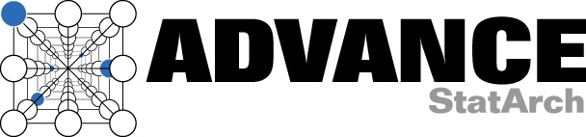


Funded by
SCIEnce (EU FP6), Grid/Cloud/Multicore coordination
  €3.2M, 2005-2012
Advance (EU FP7), Multicore streaming
  €2.7M, 2010-2013
HPC-GAP (EPSRC), Legacy system on thousands of cores
  £1.6M, 2010-2014
Islay (EPSRC), Real-time FPGA streaming implementation
  £1.4M, 2008-2011
ParaPhrase (EU FP7), Patterns for heterogeneous multicore
  €2.6M, 2011-2014

Slide 65
Industrial Connections
SAP GmbH, Karlsrühe
BAe Systems
Selex Galileo
BioId GmbH, Stuttgart
Philips Healthcare
Software Competence Centre, Hagenberg
Mellanox Inc.
Erlang Solutions Ltd
Microsoft Research
Well-Typed

Slide 66


Slide 68
Future Work
More parallel refactorings
Refactoring support for parallel patterns
  New (unified) framework for C/C++/Erlang/etc.
Refactoring language (DSL) for expressing transformations + conditions
  Language for expressing patterns?
Cost-directed refactoring
Prove soundness of refactorings
Prove that refactorings improve parallelism?
DEAL WITH SCALABILITY ISSUES

Slide 69
ParaPhrase Research Directions
What patterns are needed to cover our applications?
  standard patterns
  domain-specific patterns
  special patterns for heterogeneity
Can we program heterogeneous systems without knowing the target?
  what virtualisation mechanisms do we need
  abstract memory access, communication, state
What information is needed to exploit multicore/manycore effectively?
  metrics: execution time, memory, power
  historical v. predicted information
Is static or dynamic mapping best?

Slide 70
Conclusions
Functional Programming PLUS Refactoring
makes parallelism much easier
good speedups are possible

Slide 71
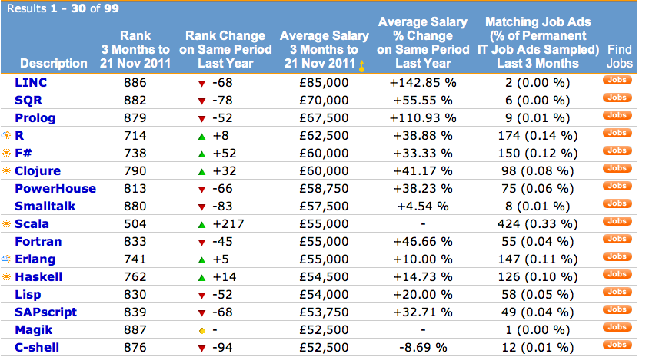
Job Trends for Programmers

Slide 72
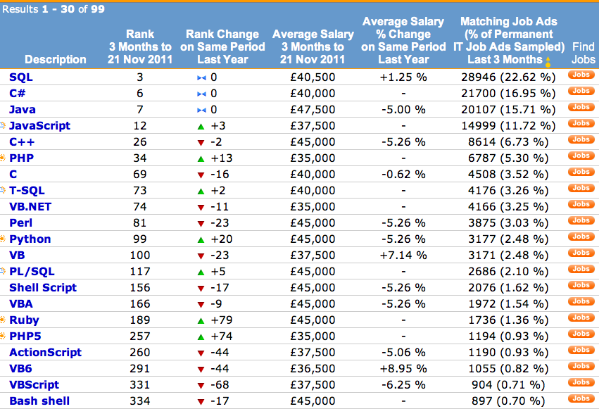

Slide 73
How Can We Think Parallel?
This is better
  but how do we get from fib to pfib?
Writing parallel Haskell program still requires
  Expertise
  Knowledge
  Trial and error!?
Very High Level Parallel Constructs may help?
  Pattern-based approaches?
Maybe tool support?
Parallelism by Construction!
Avoid issues such as deadlock etc…

Slide 74
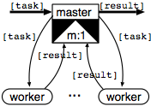
Example: Parallel Master-Worker

Slide 75
Getting Granularity Right
Too Little!!

Slide 76
Getting Granularity Right
Too Much!!

Slide 77

Getting Granularity Right
Just Right!!

Slide 78

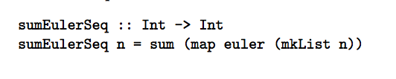
First eta-expand

Slide 79
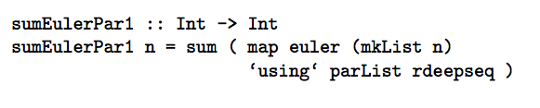
Then Introduce Data Parallelism

Slide 80
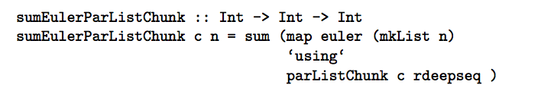
Now add chunking

Slide 81
Control Parallel Version
Control parallel version
  use divide-and-conquer version
  introduce task parallelism
  add thresholding

Slide 82
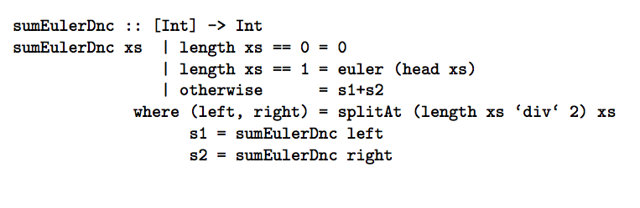
Start with a Divide-and-Conquer Version

Slide 83
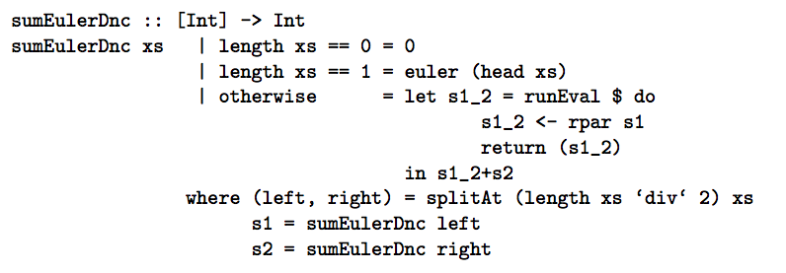
Introduce Task Parallelism

Slide 84
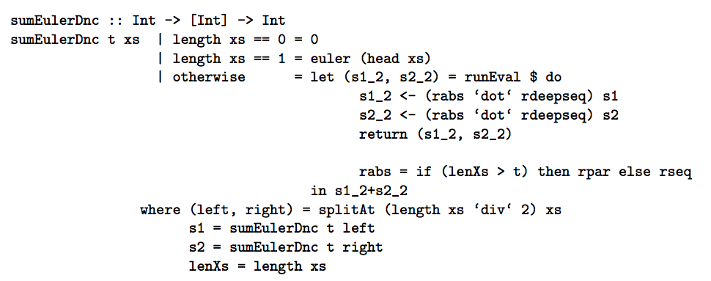
Now Introduce Thresholding

Slide 85
Introduce Threshold

Slide 86
Introduce Threshold (2)

Slide 87
Transformation Rules
Threshold added as an argument
  First position for partial applications
  Call sites updated
  Type signature updated
runEval updated
  Parallelism turned on
  Identity strategy for otherwise
Imports for rseq
Qualifications

Slide 88
Conditions
No conflicts for new threshold name
Must have an activated Eval monad
rseq must not be hidden in import
types

Slide 89
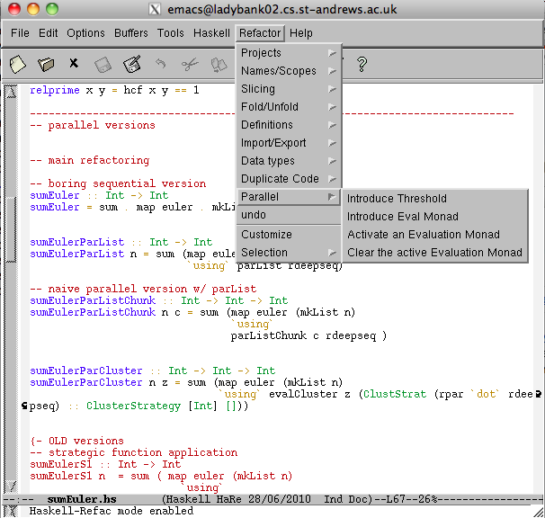

Slide 90
Project Vision

Slide 91
Feedback-Directed Compilation
Compilation Route
Source
Compiler
Object
+ LPEL
+ CAL
Object
+ SVP
Hardware
Platform
Mapping
Source
+CAL
Dynamic
Adaptation
Analysis
Route
Markov
Model
Runtime
Measurement
Source
+CAL
Statistical
Analysis
Performance
Aggregation
Aggregated
Measurements
+ SVP
Measurements
+ SVP
Feedback Route

