Slide 1
The Polyglot Rabbit and the
Big Fluffy Cloud
Adventures in HP Cloud with RabbitMQ, Erlang, and multi-protocol messaging
Brett.Cameron @hp.com

Slide 2
Abstract
RabbitMQ (http://www.rabbitmq.com) is a popular 100% Erlang-based Open Source message queuing system that implements the Advanced Message Queuing Protocol (AMQP). It has been estimated that there are presently some 30,000 production deployments of RabbitMQ across the globe, and this number is growing rapidly. Most of these deployments are business-critical, underpinning everything from internet-based pizza ordering systems through to providing the central nervous system for OpenStack-based cloud deployments. RabbitMQ currently supports versions 0.8.0 and 0.9.1 of AMQP and will soon also provide support for 1.0. However, a somewhat overlooked capability of RabbitMQ is its ability to also readily provide support via a flexible plugin architecture for a variety other popular Open Source message queuing protocols, including STOMP, MQTT, ZeroMQ, and RESTful messaging via the RabbitHub plugin. Most good message queuing protocols share many features in common; however some are better suited to a particular set of use cases than others. This ability of RabbitMQ to be able to seamlessly receive and propagate messages simultaneously via multiple protocols is an extremely powerful facility, and one that affords great flexibility. For example, it means that it is possible to use the most appropriate protocol for a particular function or to simultaneously use different protocols to disseminate the same data to different types of users via the most appropriate protocol without having to develop and maintain any separate gateway components. In this talk the presenter will discuss the multi-protocol features of RabbitMQ and how the capabilities of Erlang have been utilised to implement the powerful RabbitMQ plugin architecture. An overview of the plugin architecture will be presented along with examples of its use to implement a robust and highly scalable multi-protocol Open Source cloud-based messaging hub.

Slide 3
About me…
Brett Cameron currently works as a senior architect with HP’s corporate Cloud Services group, focusing on the design and implementation of message queuing and related integration services for customers and internal use. Brett lives in Christchurch, New Zealand and has worked in the software industry for some 20 years. In that time he has gained experience in a wide range of technologies, many of which have long since been retired to the software scrapheap of dubious ideas. Brett is involved in the research and development of low-latency and highly scalable messaging solutions for the Financial Services sector running on HP platforms and as a consequence of this work, Brett has been involved in several interesting Open Source projects. He is responsible (or should that be irresponsible) for porting various Open Source solutions (including Erlang and RabbitMQ) to HP’s “legacy” OpenVMS operating system platform. Brett holds a doctorate in chemical physics from the University of Canterbury, and still maintains close links with the University, working as a part time lecturer in the Computer Science and Electronic and Computer Engineering departments. In his spare time, Brett enjoys listening to music, playing the guitar, and drinking beer (preferably cheap Australia lager).

Slide 4
Agenda
Introduction
AMQP
RabbitMQ
RabbitMQ plugins
Multi-protocol Open Source cloud-based messaging hub
Summary
Questions
Notes:
4
4

Slide 5
Introduction
Brief overview of RabbitMQ and AMQP
RabbitMQ plugins
  Overview (what, where, why, how...)
  Plugin architecture
  RabbitMQ boot steps
Using RabbitMQ and various plugins to create a multi-protocol Open Source cloud-based messaging hub
  Setting up a RabbitMQ cluster in HP Cloud
  Cluster performance/scalability
  Multi-protocol use-cases/examples
  Futures
Wrap-up/questions
Notes:
5
5

Slide 6
Agenda
Introduction
AMQP
RabbitMQ
RabbitMQ plugins
Multi-protocol Open Source cloud-based messaging hub
Summary
Questions
Notes:
6
6

Slide 7
AMQP introduction
AMQP (Advanced Message Queuing Protocol) is an open standard application layer protocol for message oriented middleware
  It is an open protocol (like TCP, HTTP, SMTP, and so on)
The defining features of AMQP are:
    Message orientation
    Queuing
    Routing (including point-to-point and publish-and-subscribe)
    Reliability
    Security
AMQP mandates the behaviour of the messaging provider and client
  Implementations from different vendors are truly interoperable
  Previous attempts to standardise middleware have focussed at the API level
    This approach did not create interoperability
  Instead of merely defining an API, AMQP defines a wire-level protocol
    A wire-level protocol is a description of the format of the data that is sent across the network as a stream of octets
    Any tool that can create and interpret messages that conform to the defined wire-level protocol can interoperate with any other compliant tool, irrespective of implementation language

Slide 8
History
AMQP was originally designed to provide a vendor-neutral protocol for managing the flow of messages across an enterprise's business systems
AMQP was developed from mid-2004 to mid-2006 by JPMorgan Chase and iMatix
  iMatix also developed the original AMQP implementation (OpenAMQ)
    See http://www.openamq.org
JPMorgan Chase and iMatix documented the protocol and assigned it to a working group that included Red Hat, Cisco Systems, TWIST, IONA, and iMatix
As of January 2013, the working group consists of:
  Bank of America, Credit Suisse, Deutsche Börse, Goldman Sachs Group, JPMorgan Chase Bank, IIT Software, INETCO Systems, Kaazing, Microsoft, Red Hat, SITA, Software AG, Solace Systems, Thales e-Security, US Department of Homeland Security, VMware (Rabbit Technologies), WSO2
    See http://www.amqp.org
Although AMQP originated in the financial services industry, it has general applicability to a broad range of middleware problems

Slide 9
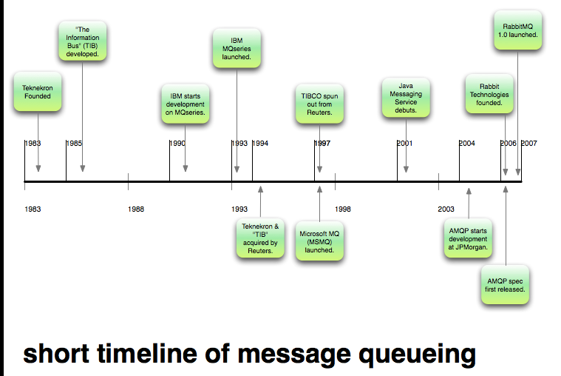
History
Diagram adapted from http://www.manning.com/videla/

Slide 10
Motivation
AMQP was born of frustration!
  Message oriented middleware needs to be everywhere in order to be useful, but…
  Traditionally dominant solutions are typically very proprietary
    They are frequently too expensive for everyday use
    They invariably do not interoperate
  The above issues with proprietary solutions have resulted in numerous home-grown developments
    Custom middleware solutions
    Custom adaptors
  The net result for a large enterprise is middleware hell
    Hundred’s of applications, thousand’s of links
    Every other connection is different
    Massive waste of effort
      Costly to implement
      Costly and difficult to maintain

Slide 11




The AMQP model – key features
Key features of AMQP include:
  Queuing with strong delivery assurances
  Event distribution with flexible routing
  Large message capability (gigabytes)
  Global addressing scheme (email-like)
  Meets common requirements of mission-critical systems
  Service oriented
Publish/
subscribe
detect
Messaging
transact
AMQP aims to become the solution for enterprise messaging: Any language, any model, any payload, any platform, reliable, interoperable, manageable, performant, scalable.
… big aspirations!
File transfer
report

Slide 12
Comparison with some other protocols
Protocol | Comments
SMTP | Unreliable, slow
HTTP | Synchronous, semi-reliable, no routing
XMPP | No delivery fidelity or queue management
FTP | Point to point, transient, does not work well with NAT/SSL
MQ | Exactly once
TCP | At least once, reliable but short lived, no application-level state management
UDP | Fast but has no delivery guarantees
AMQP can accommodate all of the above as use-cases… and switch between them (open, ubiquitous, and adaptable)

Slide 13
The AMQP model – key components
Message broker
  Applications connect to a broker to participate in the AMQP network
  The connection is used to establish a session
    Sessions provide state between connections, establish identity, ease failover
  Connections are further subdivided into channels
    Multiple threads of control within an application can share one connection
Message layer
  Exchanges
    Software switches or routers
    Message producers publish messages to exchanges
    Three basic types:
      Direct, fan-out, and topic
  Queues
    Are (essentially) FIFO containers that hold messages
    Can be memory only or backed by disk
    Have various convenience options on who can use them, automatic clean-up, and so on
  Bindings
    A binding associates an exchange with a queue
    Messages published to an exchange are routed by the exchange to any bound queues
A peer-to-peer wire protocol
Note that we are really only talking about AMQP 0.8 and 0.9.1 here. Things are a bit different with AMQP 1.0, which only defines the network wire-level protocol for the exchange of messages between two endpoints. The 1.0 standard supports exchanging messages in peer-to-peer fashion or via brokered topologies.

Slide 14
Scales of deployment
AMQP implementations can cover deployment at different levels of scale ranging from trivial to the mind-boggling... no job too big or too small.
Type of deployment | Possible scenario
Developer/casual use | 1 server, 1 user, 10 queues, 1 message per second
Production application | 2 servers, 10-100 users, 10-50 queues, 25 messages per second
Departmental mission critical application | 4 servers, 100-500 users, 50-100 queues, 250 messages per second
Regional mission critical application | 16 servers, 500-2,000 users, 100-500 queues and topics, 2,500 messages per second
Global mission critical application | 64 servers, 2K-10K users, 500-1000 queues and topics, 25,000 messages per second
Market data (trading) | 200 servers, 5K users, 10K topics, 250K messages per second
As well as volume, the latency of message transfer is often important; AMQP implementations can deliver messages with latencies of less than 200μs

Slide 15
Some typical usage patterns
Direct exchanges
  Simple point-to-point queue delivery
  Abstracted point-to-point queue
  Load-balanced point-to-point queue delivery
  RPC
Fan-out and topic exchanges
  Dynamic (non-persistent) publish/subscribe delivery
  Durable (persistent) publish/subscribe delivery
Inter-network connectivity
Let’s briefly look at the three exchange types...

Slide 16
Direct exchanges
C
P
X
M1
M2
M3
Routing key
Binding
C
Queue
Point to point messaging
A single message that needs to be sent to a single recipient
Can have multiple consumers (load will be balanced across them)
Notes:
Now that I’ve provided some background on what AMQP, it is time to explain a few key AMQP concepts. Like most messaging platforms, RabbitMQ supports the concept of point to point messaging, which is just a fancy way of saying, I have a single message that needs to be sent to a single recipient. In AMQP we use a “Direct Exchange” to do point to point messaging.
The cornerstone of AMQP is the concept of an “exchange”. Exchanges are stateless message routers that handle all incoming messages. You will bind an exchange to a message queue, in this case, we will create a “binding” called “marriott” that will route hotel booking messages from the exchange to the “marriott” queue. The “P” icon is for message producers. A message producer will send a message using a “routing” key. I this case, the routing key will match the binding name, but that is not a requirement. “C” stands for a message consumer. Message consumers will connect directly to the RabbitMQ server and queue. You can have as many consumers as you want and those consumers usually stay connected to the messaging system and pull messages as fast as they can process them.
The message producer will send message one, two and three. Each message will be queued in a “Weak FIFO” order and processed first in/first out style. It is important to note that RabbitMQ does not guarantee message ordering and it is a bad idea to require message ordering for application to application communication, because it is a performance killer.

Slide 17
Fan-out exchange
C
Same message sent to multiple queues/recipients
M1
M2
M3
C
Queue 1
P
X
C
M1
M2
M3
Queue 1
C
M1
M2
M3
Queue 3
A fan-out exchange is a “publish-subscribe” mechanism
Used to send a single message to multiple recipients (very similar to an email distribution list)
Any queue bound to a fan-out exchange will receive any message sent to the exchange
Message consumption of each queue will be dependent on the number of consumers and speed of message consumption
Notes:
Fan-out exchanges have all of the same characteristics of a Direct Exchange except for one key difference. A Fanout exchange is known as a “publish-subscribe” mechanism, which is a fancy way of saying that I need to send a single message to multiple recipients, very similar to an email distribution list. Any queue bound to a fan-out exchange will receive any message sent to the exchange. And, message consumption of each queue will be dependent on the number of consumers and speed of message consumption.

Slide 18
Topic exchange
C
Binding pattern A
M1
M2
M3
Queue 1
P
X
Binding pattern B
C
M1
M2
Queue 2
Binding pattern C
C
M1
Queue 3
Content-based routing mechanism
Messages posted to queues based on binding pattern (PCRE used)
Very powerful mechanism
Notes:
The fan-out exchange provides a simple publish-subscribe model, but AMQP also supports a more powerful content based router mechanism called a topic exchange. In this example, we have three different queues, one for all hotel bookings, whether they are made via orbitz, travelocity or expedia, one for just orbitz bookings and another for orbitz bookings to the marriott hotel chain.
We will use a binding pattern to control message flow. For the first queue, any message that has a routing key that starts with “booking.” will go to the all_bookings queue because we are using the pound sign, a multi-word pattern symbol. The second queue is bound by an asterisk which will match all single word values. Our last binding requires an exact match because it doesn’t use an asterisk or pound symbol.
The first message goes to all three queues. The second message doesn’t match the routing key pattern for queue #3. The third message only matches our least specific filter, “all_bookings”.

Slide 19
Agenda
Introduction
AMQP
RabbitMQ
RabbitMQ plugins
Multi-protocol Open Source cloud-based messaging hub
Summary
Questions
Notes:
19
19

Slide 20
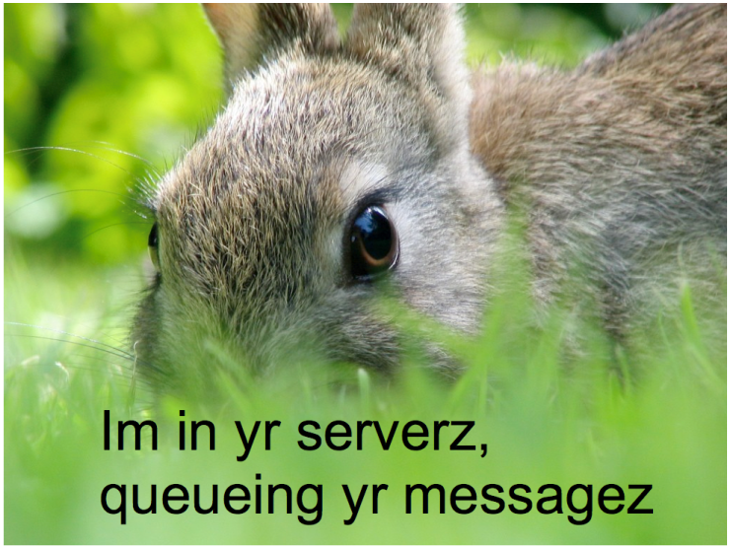

Slide 21

What is RabbitMQ?
A powerful Open Source message broker (message-oriented middleware)
  The leading (and arguably the most popular) implementation of AMQP
  Provides a robust and flexible messaging platform designed to interoperate with other messaging systems
  See http://www.rabbitmq.com for more information
A multi-protocol broker engine implemented in Erlang for exceptional scalability and fault-tolerance
  100% Erlang/OTP (an inspired move)
RabbitMQ essentially comprises the following components:
  The RabbitMQ broker (supports AMQP 0.8 and 0.9.1, and will soon support 1.0)
  Adapters for HTTP, ZeroMQ, STOMP, MQTT, ZeroMQ, and other protocols
  AMQP client libraries for Erlang, Java, .NET, and C/C++
    AMQP clients for numerous other languages are available from other vendors and/or the Open Source community
      Python, Ruby, PHP, ... just about any language you can think of
  Large assortment of useful plugins

Slide 22
Very brief RabbitMQ history
2006
  Rabbit Technologies Ltd. founded and the first version of RabbitMQ was born
  RabbitMQ source code is released under the Mozilla Public License
2006 – today
  Rapid adoption (good product, catchy name, excellent support), incremental rollout of new features
April 2010
  Rabbit Technologies Ltd. was acquired in April 2010 by VMware
  RabbitMQ team now based in the London VMware building (with a nice view over some nice bits of London)

Slide 23
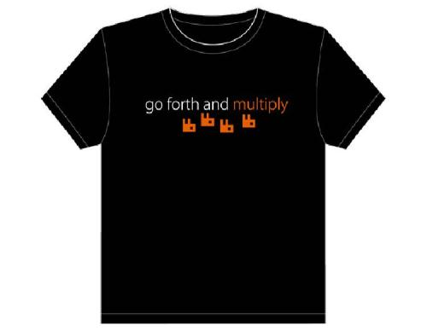
RabbitMQ cloud-scale features
In the next few slides we’ll have a quick look at:
  Scalability through clustering
  High-availability
  Management and monitoring
  Security
  T-shirt sizes to suit all requirements

Slide 24
Scalability with RabbitMQ clustering
RMQ Cluster1
RMQ1
P
X
Queue 1
1
P
RMQ2
X
Queue 2
C
2
P
RMQ3
X
Queue 3
C
3
Clustering can be used to elastically scale the messaging infrastructure
Producers and consumers can send and retrieve messages by connecting to any broker in the cluster, allowing load to be spread evenly and avoid having a single point of failure for all queues
A queue only lives on one cluster node (actually, with HA queue replication, it's not quite that simple... see next slide)
Consumers are able to retrieve any message from any queue in the cluster, even if they are not connected to the server that owns the queue
By using clustering, you can add new queues on new brokers without re-configuring clients
Notes:
There are other aspects to AMQP that we are not going to cover today, like security and transactions, but having an understanding of Direct Exchanges, Fanout Exchanges and Topic Exchanges are crucial for both the application and infrastructure teams. Now, I’m going to spend some time on a feature that is not related to AMQP, but that is more of an infrastructure concern.
In RabbitMQ, you can create a clustered configuration. You can use clustering to elastically scale your messaging infrastructure. There are a few key points to keep in mind when you use a clustered configuration. First, the message producers and message consumers can send and retrieve messages by connecting to any server in the cluster. In this way, you can spread load evenly and avoid having a single point of system failure for all queues.
Secondly, Highlander rules apply for queues in a cluster. A queue only lives on one cluster node. For example, the marriott queue will live on only one RabbitMQ server.
In this example, we have three RabbitMQ servers in one cluster. Each RabbitMQ server owns a single queue. For message one, the message producer is sending a message that will be routed to the same server that the producer is connected to. But, message two has a routing key that is bound to a queue that is owned by a different server in the cluster. Message 2 will get routed from the server that the producer is connected to, RMQ2, to the server that owns the queue, RMQ3. For message 3 the producer will send the message to RMQ3 and RMQ3 will forward that message to RMQ2.
Message consumers are able to retrieve any message from any queue in the cluster, even if it is not connected to the server that owns the queue. In this case a message consumer can retrieve messages from RMQ1 even though it is connected to RMQ2.
By using clustering, you can add new queues on new servers without re-configuring your messaging clients to communicate with those newly added servers.

Slide 25
High availability
C
P
C
master
P
C
slave
Node A
ESX1
Node B
RMQ1
RMQ1
RMQ2
Queue 1
X
sheraton.queue
Queue 1
X
X
Queue 2
Queue 2
marriott.queue
marriott.queue
Highly available, mirrored queues – this is a relatively new RabbitMQ feature that was introduced in version 2.7.0
Potentially better performance and less downtime
Downside is more network traffic inside the RabbitMQ cluster as messages are replicated to slave queues on message send
Need to add a little code to clients to make them HA cluster aware (so they will try a backup server when a primary connection fails)
Notes:
If we can accept a few minutes of downtime, the vSphere based Highly Available model will work well. But, if zero down time is allowed, there is a new RabbitMQ feature in development that can be used. We call this feature “Highly Available, Mirrored Queues”. In this configuration, we do not need to use disk persistence. The end result is better performance and zero downtime. The downside to this approach is that there will be more network traffic inside of the RabbitMQ cluster. The extra network traffic involves copying messages to “slave” queues on message send.
In this example, we have 2 RabbitMQ servers. RMQ1 is the master server for the marriott queue and a slave for the sheraton queue, while RMQ2 is a master for the sheraton queue and a slave for the marriott queue. If RMQ1 goes down, RMQ2 will become the master for the marriott queue.
If we leave vSphere HA enabled, RMQ1 will be vmotioned to another ESX host, in this case ESX4. When RMQ1 is restarted on a working host, it will be a slave for both the sheraton and marriott queue and we will re-establish our at least one backup fault tolerance level with no administration effort.
The message producers and consumers that were trying to use RMQ1 will need to wait for RMQ1 to come back up to send/receive messages, but if we are smart, we will have message producers and consumers for all queues connected to both RMQ1 and RMQ2. The alternative is to add a little error handling code on the message clients to try a backup server when a connection is severed.

Slide 26
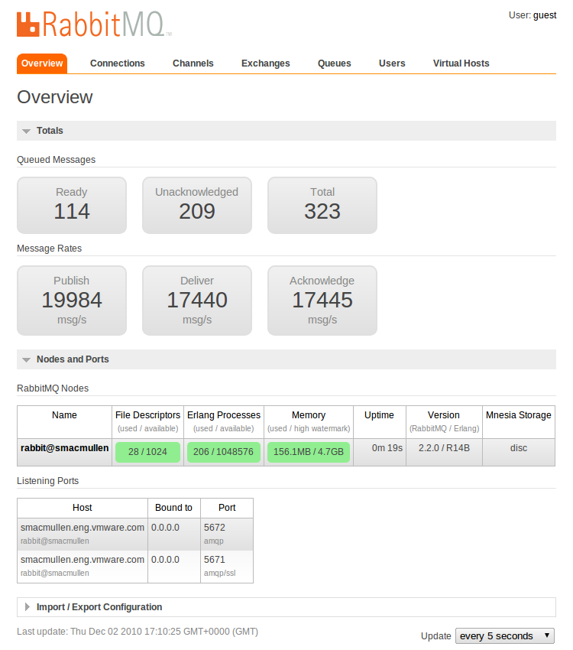
Management and monitoring
The rabbitmq-management plugin provides an HTTP-based API for management and monitoring the RabbitMQ broker
Two tools are provided that use this API:
  A powerful browser-based UI
  A powerful command line tool (rabbitmqadmin)
  rabbitmqadmin can perform the same actions as the web-based UI, and is convenient for use when scripting
Or you can use the API to develop your own tools...

Slide 27

Security
Virtual hosts (vhosts):
  When an AMQP client establishes a connection to an AMQP server, it specifies a virtual host within which it intends to operate
  A first level of access control is enforced at this point, with the server checking whether the user has any permissions to access the virtual hosts, and rejecting the connection attempt otherwise
  Vhosts are essentially independent RabbitMQ message brokers within the RabbitMQ process with their own queues, exchanges, permissions, and so on
Users and permissions:
  A second level of access control is enforced when certain operations are performed on resources
    Resources (exchanges and queues) are named entities inside a particular virtual host
  RabbitMQ distinguishes between configure, write, and read operations on a resource
    Configure operations create or destroy resources, or
    alter their behavior
    Write operations inject messages into a resource
    Read operations retrieve messages from a resource

Slide 28
Some other AMQP implementations
OpenAMQ (http://www.openamq.org)
  Original Open Source implementation of AMQP, written in C by iMatix
    No longer supported (sadly)
  Runs on Linux, AIX, Solaris, Windows, OpenVMS, HP-UX
  Includes broker, APIs in C/C++ and Java JMS, remote administration shell, scripting, federation, failover, and AMQP-over-HTTP via the RestMS protocol
Apache Qpid (http://qpid.apache.org/)
  A project in the Apache Foundation
  Includes broker and APIs that support C++, Ruby, Java, JMS, Python and .NET; AMQP 1.0 support
Red Hat Enterprise MRG (http://www.redhat.com/mrg/)
  Rich set of features including management, federation, Active-Active clustering, and APIs for C++, Ruby, Java, JMS, Python .NET; AMQP 1.0 support
SwiftMQ (http://www.swiftmq.com/)
  An enterprise-grade JMS messaging product with full support for AMQP 1.0
StormMQ (http://stormmq.com/)
  A cloud-hosted messaging service based on AMQP

Slide 29
Agenda
Introduction
AMQP
RabbitMQ
RabbitMQ plugins
Multi-protocol Open Source cloud-based messaging hub
Summary
Questions
Notes:
29
29

Slide 30

RabbitMQ plugins
RabbitMQ provides a highly flexible plugin system
  Provides a powerful facility for extending or supplementing the capabilities of the RabbitMQ broker
  Provides an interface into core RabbitMQ functionality

Slide 31
What can you do with plugins?
Add support for other messaging protocols
  STOMP
  WebSockets
  MQTT
  HTTP/REST
  ZeroMQ
Alternative authentication mechanisms
  LDAP
  SSL
  Kerberos (work in progress)
  OpenStack Keystone?
Implement alternative message stores
Add extra functionality to the RabbitMQ broker
  RabbitMQ Management plugin
  RabbitMQ Shovel plugin
Create new exchange types
  Random exchange
  Consistent hash exchange
  Riak exchange
  Global fanout exchange
  Recent history exchange
See http://www.rabbitmq.com/plugins.html for a more complete list of official and community-developed plugins.

Slide 32
Why write a plugin?
Enable your application to access internal RabbitMQ functionality that is not exposed via the AMQP interface
Plugins run in the same Erlang VM as the RabbitMQ broker
  This may improve performance for certain applications
Can simplify deployment
  Plugins can be packed with the broker as a single deployable unit
Plugins must be written in Erlang and run in the same Erlang VM as the broker.

Slide 33
Comments on writing plugins
Not going to go into the gory details
  The RabbitMQ team provides the RabbitMQ Public Umbrella to assist with plugin development
    See http://www.rabbitmq.com/plugin-development.html and http://manning.com/videla/
  Study and borrow code from existing plugins!
Desirable to have a reasonable knowledge of RabbitMQ internals
  API’s
  Boot steps
  ...
Beware of minor changes to internals between versions
  Can break plugins
  Far less of a problem with newer versions of RabbitMQ, but be careful

Slide 34
RabbitMQ boot steps
When RabbitMQ starts it goes through a series of “boot steps”
  These steps take care of initializing the core components of the broker in a specific order
    The idea is that each sub-system that forms part of RabbitMQ as a whole will declare on which other sub-systems it depends and, if it is successfully started, which other systems it will enable
  The boot step approach seems quite unique to RabbitMQ
    Although others have now borrowed the idea…
The "boot step" implementation relies on adding custom attributes to Erlang modules that declare:
  How to start a boot step
  What other boot steps it depends on; and
  Which boot steps it will enable
  ... all very sneaky
Boot steps take care of starting the many sub systems that compose RabbitMQ respecting order and dependencies. The boot step approach was devised by Tony Garnock-Jones (http://homepages.kcbbs.gen.nz/tonyg/), one of the original RabbitMQ developers.
Much of this material is adapted from https://github.com/videlalvaro/rabbit-internals.

Slide 35
RabbitMQ boot steps
Consider the "recovery" boot step:
This boot step:
  Requires the empty_db_check boot step to have been performed; and
  Enables the routing_ready boot step
  The mfa directive specifies the module:function to call in order to perform this boot step and the arguments for the call
    There may be zero or more mfa directives
Seems simple enough... what's the big deal?... why not just have a simple sequence of function calls?
-rabbit_boot_step({recovery,
[{description, "exchange, queue and binding recovery"},
{mfa, {rabbit, recover, []}},
{requires, empty_db_check},
{enables, routing_ready}]}).
Well, it’s not quite that simple...

Slide 36
RabbitMQ boot steps
Boot steps can be separated into groups
  One group of boot steps can be enabled by another
    For example, routing_ready may be enabled by many other boot steps, not just the recovery boot step
      One of such step is the empty_db_check
        This step ensures that the RabbitMQ's Mnesia database is correctly initialized
      The recovery boot step also depends on empty_db_check
    This logic ensures that steps are performed in the correct order to satisfy any interdependencies
Some boot steps don't enable or require others…
  They are used to signal that a group of boot steps have happened as a whole, so that the next group can start running
But wait, there’s more...

Slide 37
RabbitMQ boot steps
Boot steps are very important with regard to plugins…
  Plugins may require certain boot steps to occur before the plugin can be started
  Plugins can depend on other plugins
  Plugins can have their own specific boot sequences
  The boot step mechanism makes it possible for developers to implement plugins without having to overly concern themselves with when other components will be started
    It is just a case of specifying the relevant dependencies ("requires"), and the RabbitMQ boot process will take care of the rest
  Consider the following boot step for the RabbitHub plugin:
    RabbitHub cannot be started until routing_ready has been enabled
    Starting RabbitHub involves the execution of several functions as per the mfa directives
-rabbit_boot_step({?MODULE,
[{description, "RabbitHub"},
{mfa, {rabbithub, setup_schema, []}},
{mfa, {rabbit_sup, start_child, [rabbithub_sup]}},
{mfa, {rabbithub_web, start, []}},
{mfa, {rabbithub_subscription, start_subscriptions, []}},
{requires, routing_ready}]}).

Slide 38
RabbitMQ boot steps
So how does it all work?
  Erlang modules can have attributes
    Lists of exported functions
    Behavior declarations
    ...
  But how does this funny -rabbit_boot_steps attribute thing work?
    Well...
      When the RabbitMQ broker starts it builds a list of all the modules defined in the loaded applications
      This list is scanned for attributes called rabbit_boot_steps
      Any rabbit_boot_steps found are added to a new list
      This list is then processed into a directed acyclic graph (DAG, see http://en.wikipedia.org/wiki/Directed_acyclic_graph)
      The DAG is used to maintain an order between the boot steps subject to constraints that certain steps must be performed before others
        In other words, the boot steps are ordered according to their dependencies)
As commented by Alvaro Videla (co-author of “RabbitMQ in Action”, http://manning.com/videla/), the ability to implement such a facility says something about the flexibility of Erlang: Add declarations to modules in the form of custom module attributes, scan for them and do something smart with the information... nice.

Slide 39
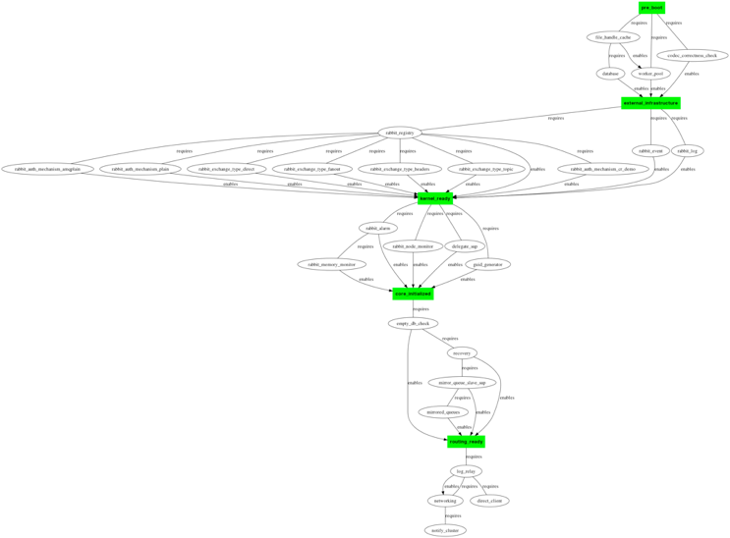
And here’s what the standard RabbitMQ boot steps DAG looks like (courtesy of Alvaro Videla) with key grouping points highlighted.

Slide 40
RabbitMQ boot steps
Booting up a sophisticated Erlang application like RabbitMQ is not a trivial task
The boot step approach manages this task in an efficient and elegant way
  Adds order
  Adds flexibility
Additionally, the boot step technique forms a critical aspect of extending the broker via plugins
  Developers can add their own boot steps to hook up into the server boot process
If you're really keen you can even add extra boot steps in between RabbitMQ's predefined boot steps

Slide 41
Agenda
Introduction
AMQP
RabbitMQ
RabbitMQ plugins
Multi-protocol Open Source cloud-based messaging hub
Summary
Questions
Notes:
41
41

Slide 42
Multi-protocol Open Source cloud-based messaging hub
Multi-protocol messaging
Cluster configuration
Multi-protocol messaging examples

Slide 43
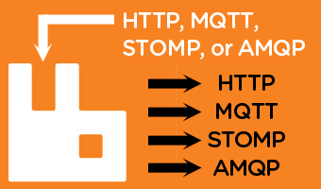
Multi-protocol messaging
Via its powerful plugin mechanism the RabbitMQ broker is able to support other message queuing protocols in addition to AMQP
  What does this mean and why should you care?

Slide 44
Flexibility
The notion of a “one-size-fits-all” messaging protocol is flawed
  Some messaging protocols are optimized for low-latency transmission of small messages
    Others are designed for efficient transmission of large messages
  Some messaging protocols sacrifice performance for reliability
    Others favor performance at the risk of occasional message loss
  ...
The world is not uniform
  There are clearly advantages to being able to communicate with people in multiple languages
    In an analogous fashion there are advantages to message queuing software being able to accommodate and seamlessly map between different message queuing protocols
Any attempt to accommodate all possible messaging scenarios within the scope of a single ubiquitous protocol must entail some level compromise
  The resultant protocol will be less well-suited to one or more messaging scenarios over a less generic protocol that is optimally designed for a specific use case

Slide 45
Adaptability
Most good message queuing protocols share many features in common
  However some are better suited to a particular task than others
Change is constant
  What may seem like a good idea today may not be such a good idea tomorrow
  If software cannot readily (and potentially rapidly) adapt to change then it will become extinct

Slide 46
Other protocols supported by RabbitMQ
STOMP
  http://stomp.github.com
  https://www.rabbitmq.com/stomp.html (supports STOMP 1.0, 1.1, and 1.2)
MQTT (MQ Telemetry Transport)
  http://mqtt.org/
  http://www.rabbitmq.com/blog/2012/09/12/mqtt-adapter/
ZeroMQ
  http://www.zeromq.org/
  https://github.com/rabbitmq/rmq-0mq/wiki
  Plugin code needs some updating to work with current RabbitMQ versions
HTTP/REST via the RabbitHub plugin
  https://github.com/tonyg/rabbithub
  Recently updated to be compatible with current RabbitMQ versions
Web-STOMP (STOMP + WebSockets)
  http://www.rabbitmq.com/blog/2012/05/14/introducing-rabbitmq-web-stomp/
... and a few others
Whilst there are some limitations in terms of fully mapping some of the protocols to the AMQP 0.9.1 model, these limitations are generally insignificant compared to the capabilities that the plugins provide.

Slide 47

STOMP
Simple (or Streaming) Text Orientated Messaging Protocol (http://stomp.github.com/)
  A simple to use and easy to implement protocol
  Designed for asynchronous message passing between clients via mediating servers
  Defines a text-based wire format for messages passed between clients and servers
  Lightweight alternative to other open messaging protocols applicable to simple messaging scenarios
  Maps very well to AMQP 0.9.1
  Clients available for numerous languages, including Erlang

Slide 48
MQTT
Designed to facilitate the transfer of telemetry-style data to a server or message broker from pervasive devices over high-latency or otherwise constrained networks
  Sensors and actuators
  Mobile phones
  Embedded systems on vehicles
  Laptops and other computing devises
Invented by Andy Stanford-Clark of IBM, and Arlen Nipper of Cirrus Link Solutions
Maps well to AMQP 0.9.1
Clients available in various languages
  The Paho project (C and Java clients; see http://www.eclipse.org/paho/)
  Several Erlang implementations
    http://code.google.com/p/mqtt4erl (needs some TLC, but works well)
    https://github.com/jinnipark/fubar
      Erlang client and broker
      New
      Looks promising

Slide 49
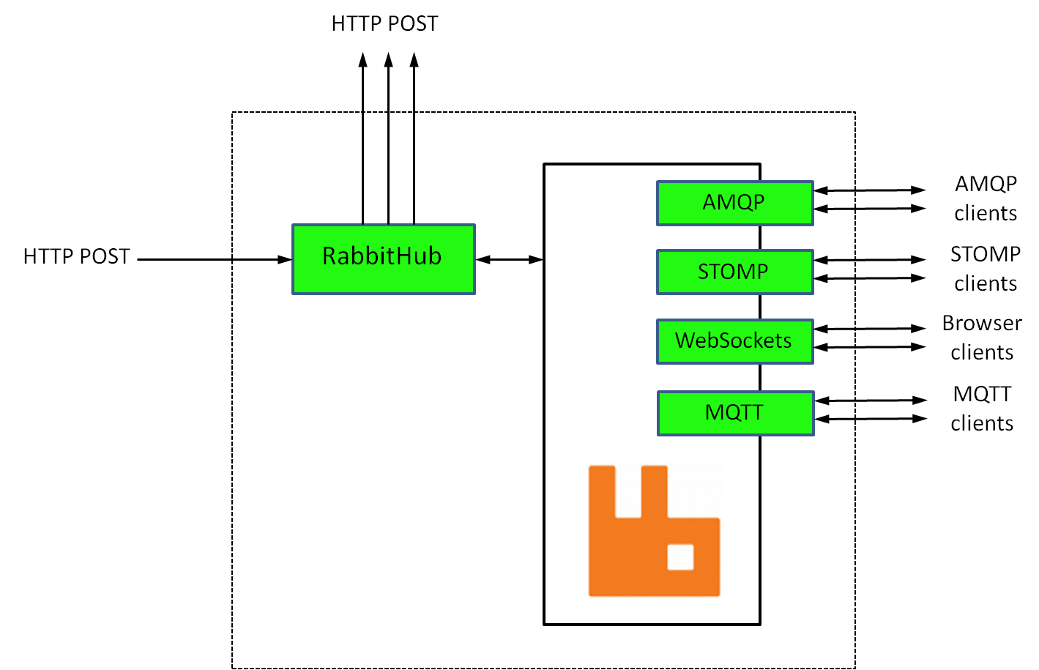
The RabbitHub plugin
A simple web-hook-based pub/sub mechanism that provides an HTTP-based interface to RabbitMQ
Gives every AMQP exchange and queue hosted by the broker two URL’s:
  One to use for delivering messages to the exchange or queue
  One to use to subscribe to messages forwarded on by the exchange or queue
Subscriptions supply a callback URL to RabbitHub that is used to deliver messages via HTTP POST
Provides a generally useful, easy to
use, and efficient means of interacting
with RabbitMQ in a RESTful manner
When used in combination with other
protocol plugins such as those for STOMP,
MQTT, and WebSockets, the result is
an extremely powerful and flexible
messaging solution.

Slide 50
Open standards
AMQP, HTTP, ZeroMQ, MQTT, STOMP
  All are essentially Open Standards
One of the key motivations behind the creation of AMQP was to escape the “middleware hell” (John O’Hara, father of AMQP)
  Multiple proprietary message queuing products scattered across the enterprise
    License costs
    Different proprietary protocols
    Gateways and adapters required to integrate between them
      Development costs
      Costly on-going maintenance and support
      ...
There is a significant difference between developing gateways and adapters to bridge proprietary messaging technologies and having a core open messaging technology such as RabbitMQ that can be readily extended via plugins to facilitate multi-protocol communication amongst a set of Open Standards-based messaging protocols.

Slide 51
HP Cloud
See http://www.hpcloud.com
Provides public cloud infrastructure that is business grade, Open Source-based, …
Initially Infrastructure as a Service (IaaS) offerings such as Compute, Object Storage, and Block Storage services
  Now expanding to include additional services (partner and HP-developed)
Publicly launched May 2012
  Built on HP hardware (obviously)
  2000+ nodes and growing
  1000’s of sign-ups, and continued good up-take
Underpinned by OpenStack (http://www.openstack.org/)

Slide 52
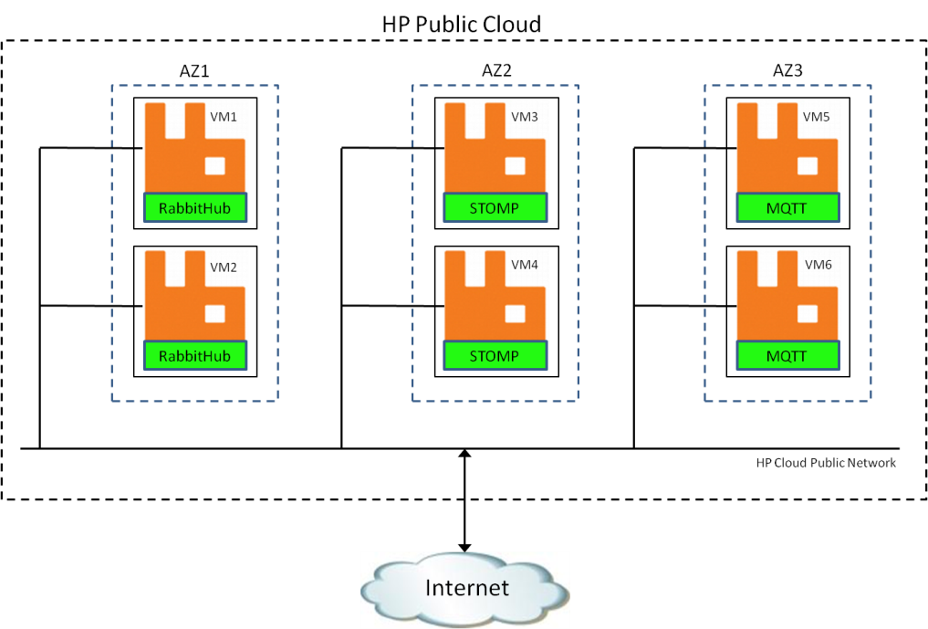
Cluster configuration
  Two nodes in each Availability Zone (AZ)
  Ubuntu 12.04 LTS 64-bit, 8 vCPU, 32GB RAM
  RabbitMQ 2.8.7
  Erlang OTP 15B02 (Erlang Solutions distribution)
  RabbitMQ STOMP 2.8.7 plugin
  RabbitMQ MQTT 2.8.7 plugin
  RabbitHub plugin (version 0.0.1)
  Different protocol plugins enabled in each AZ
A 6-node RabbitMQ cluster was created for experimentation purposes on HP Cloud. Whilst such a lavish configuration is most certainly not required in order to experiment with the different protocol plugins, using a cluster with different plugins enabled on different nodes serves as a means of demonstrating the perhaps obvious fact that messages published via one protocol to one of the cluster nodes can be consumed via different protocols from other cluster nodes.

Slide 53
Cluster configuration
Cluster configuration is largely as per http://www.rabbitmq.com/clustering.html
There are a few considerations when setting up a RabbitMQ cluster on HP Cloud (OpenStack):
  Ensure all relevant firewall ports are open
    5672 (AMQP), 4369 (empd), 61613 (STOMP), 1883 (MQTT), and 55670 (RabbitHub)
  Use Erlang inet_dist_listen_min and inet_dist_listen_max parameters to constrain the port range used for intra-cluster communication
    Specify these in rabbitmq.config
  Ensure that compute instances (VM's) can see each other
    Enter names and addresses into /etc/hosts, use DNS, or whatever
    Remember that hostnames =:= node names
  Consider placing the Mnesia partition under /mnt in order to avoid any flow control issues associated with RabbitMQ’s disk space monitoring
    The / filesystem on larger HP Cloud instances is small relative to RAM
  Similar considerations apply when setting up a cluster on EC2
    See http://karlgrz.com/rabbitmq-highly-available-queues-and-clustering-using-amazon-ec2 for additional information

Slide 54
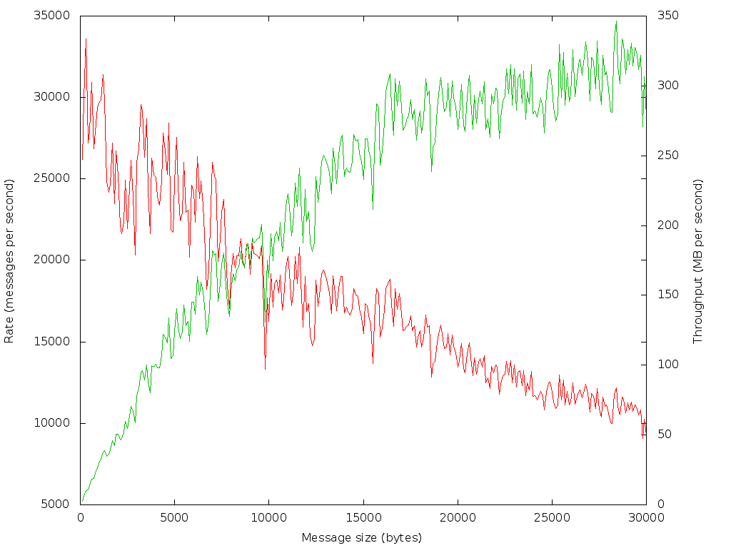
Cluster performance/scalability
RabbitMQ cluster performance on HP Cloud is generally very good
  No particular tuning required
  Mileage may vary, depending on messaging use-case
AMQP message rates on the order of 30,000 messages second are routinely achievable
  Publish and consume
  Non-persistent messages
  Strong function of message
  size
Keep in mind that not all
protocols and clients are born
equal
  For example HTTP is inherently
  request/response
Need to be aware of any cloud-
imposed throttles
  Bandwidth throttling for example

Slide 55
Examples of multi-protocol messaging
The key point is that you can mix and match
  You can publish messages via one protocol and consume them via another (or indeed simultaneously via several others).
  The ability of RabbitMQ to be able to seamlessly receive and propagate messages simultaneously via multiple protocols is an extremely powerful facility, and one that affords great flexibility
Some simple examples...
  Publish via AMQP; consume via STOMP
    Default exchange
    Fanout exchange
    Add in an HTTP consumer
  Publish via HTTP and STOMP; consume via AMQP, STOMP, and HTTP
  Publish via MQTT; consume via STOMP
  And of course other combinations are also possible
    See http://assortedrambles.blogspot.co.nz/2012/11/the-polygot-rabbit.html for more information and examples

Slide 56
Publish via AMQP; consume via STOMP
RabbitMQ Erlang client (http://www.rabbitmq.com/erlang-client-user-guide.html)
-module(amqp_publish).
-include("amqp_client.hrl").
-compile([export_all]).
test() ->
{ok, Connection} = amqp_connection:start( #amqp_params_network{
host = "az1-2xl-1",
username = <<“guest">>,
password = <<“guest">>}),
{ok, Channel} = amqp_connection:open_channel(Connection),
Payload = <<"Hello from Erlang client!">>,
Publish = #'basic.publish'{exchange = <<>>, routing_key = <<"stomp">>},
amqp_channel:cast(Channel, Publish, #amqp_msg{payload = Payload}),
amqp_channel:close(Channel),
amqp_connection:close(Connection),
ok.
Simple example; publishes messages via AMQP to the default exchange with routing key “stomp”, which maps to “stomp” queue created by the consumer...
Uses https://github.com/igb/Erlang-STOMP-Client
-module(stomp_consumer).
-export([start/0]).
start() ->
MyFunction=fun([_, _, {_, X}]) -> io:fwrite("~s~n", [X]) end,
Conn = stomp:connect("az2-2xl-1", 61613, "guest", "guest"),
stomp:subscribe("/queue/stomp", Conn, []),
stomp:on_message(MyFunction, Conn).

Slide 57
Publish via AMQP; consume via STOMP
As per the previous example, but this time we’ll publish messages to the built-in fanout exchange (amq.fanout). Messages will be routed to any queue bound to the exchange.
-module(amqp_publish).
-include("amqp_client.hrl").
-compile([export_all]).
test() ->
{ok, Connection} = amqp_connection:start( #amqp_params_network{
host = "az1-2xl-2",
username = <<"guest">>,
password = <<"guest">>}),
{ok, Channel} = amqp_connection:open_channel(Connection),
Payload = <<"Fanout message from Erlang client!">>,
Publish = #'basic.publish'{exchange = <<"amq.fanout">>, routing_key = <<>>},
amqp_channel:cast(Channel, Publish, #amqp_msg{payload = Payload}),
amqp_channel:close(Channel),
amqp_connection:close(Connection),
ok.
And let’s have a couple of different consumers...

Slide 58
Publish via AMQP; consume via STOMP
Python AMQP consumer:
import pika
creds = pika.PlainCredentials(username='guest', password='guest')
params = pika.ConnectionParameters(host='az3-2xl-2', credentials=creds)
conn = pika.BlockingConnection(params)
chan = conn.channel()
res = chan.queue_declare(exclusive=True)
q = res.method.queue
chan.queue_bind(exchange='amq.fanout', queue=q)
def callback(chan, method, properties, body):
print "%r" % (body,)
chan.basic_consume(callback, queue=q)
chan.start_consuming()
Both consumers will receive copies of any messages published to the amq.fanout exchange, regardless of consumer protocol.
Erlang STOMP consumer:
-module(stomp_consumer).
-export([start/0]).
start() ->
MyFunction=fun([_, _, {_, X}]) -> io:fwrite("~s~n", [X]) end,
Conn = stomp:connect("az2-2xl-1", 61613, "guest", "guest"),
stomp:subscribe("/exchange/amq.fanout", Conn, []),
stomp:on_message(MyFunction, Conn).

Slide 59
Add in an HTTP consumer
Using the RabbitHub plugin we can add into the mix an HTTP consumer. This can be readily achieved using a simple piece of Ruby/Sinatra code.
require 'sinatra'
get '/hubsub' do
puts "Received #{params}"
puts "Responding to challenge request..."
params[:"hub.challenge"]
end
post '/hubsub' do
puts "Received message: #{params} "
end
And the following cURL command may then be used to register our Ruby/Sinatra callback with RabbitHub:
curl -vd "hub.mode=subscribe&hub.callback=http://10.1.1.251:4567/hubsub&hub.topic=foo\
&hub.verify=sync&hub.lease_seconds=86400" \
http://guest:guest@az1-2xl-1:55670/subscribe/x/amq.fanout
Now, in addition to going to our STOMP and AMQP consumers, any messages posted to the amq.fanout exchange will also be received via HTTP by our Ruby/Sinatra consumer.

Slide 60
Publish via STOMP and HTTP
Further extending the fanout example, we in addition to consuming messages via multiple protocols, we can also publish via multiple protocols.
Via STOMP:
-module(stomp_publish).
-export([start/0]).
start() ->
Conn = stomp:connect("az2-2xl-1", 61613, "guest", "guest"),
stomp:send(Conn, "/exchange/amq.fanout", [], "This is a test"),
stomp:disconnect(Conn).
Via HTTP/RabbitHub:
curl -v -d "Hello via HTTP" \
http://guest:guest@az1-2xl-1:55670/endpoint/x/amq.fanout?hub.topic=anything

Slide 61
Publish via MQTT; consume via STOMP
Erlang MQTT publisher code:
-module(mqtt_publish).
-export([start/0]).
start() ->
mqtt_store:start(),
{ok, Pid} = mqtt_client:connect("az3-2xl-1", 1883, []),
mqtt_client:publish(Pid, "MQTT Example", "Hello World!"),
mqtt_client:disconnect(Pid).
Uses http://code.google.com/p/mqtt4erl
Erlang STOMP consumer:
-module(stomp_consumer).
-export([start/0]).
start() ->
MyFunction=fun([_, _, {_, X}]) -> io:fwrite("~s~n", [X]) end,
Conn = stomp:connect("az2-2xl-1", 61613, "guest", "guest"),
stomp:subscribe("/topic/MQTT Example", Conn, []),
stomp:on_message(MyFunction, Conn).

Slide 62
Agenda
Introduction
AMQP
RabbitMQ
RabbitMQ plugins
Multi-protocol Open Source cloud-based messaging hub
Summary
Questions
Notes:
62
62

Slide 63
Summary
RabbitMQ is a humble and modest polyglot
  It does not boast about its ability to speak multiple languages and different dialects of the same language
    But perhaps it should
    The ability to be able to seamlessly receive and propagate data via multiple protocols affords great flexibility
    It means that it is possible to use the most appropriate protocol for a particular function or to simultaneously use different protocols to disseminate the same data to different types of users via the most appropriate mechanism without having to develop and maintain separate gateway components
  Polyglot nature/capabilities heavily underpinned by Erlang
Open Source
  Large and active communities
  Client APIs available in numerous languages for all of the messaging protocols mentioned
Open Standards

Slide 64
Agenda
Introduction
AMQP
RabbitMQ
RabbitMQ plugins
Multi-protocol Open Source cloud-based messaging hub
Summary
Questions
Notes:
64
64

Slide 65

Questions?
Some of the slides in this presentation are adapted from material kindly made available by the RabbitMQ team.

